Slide 1
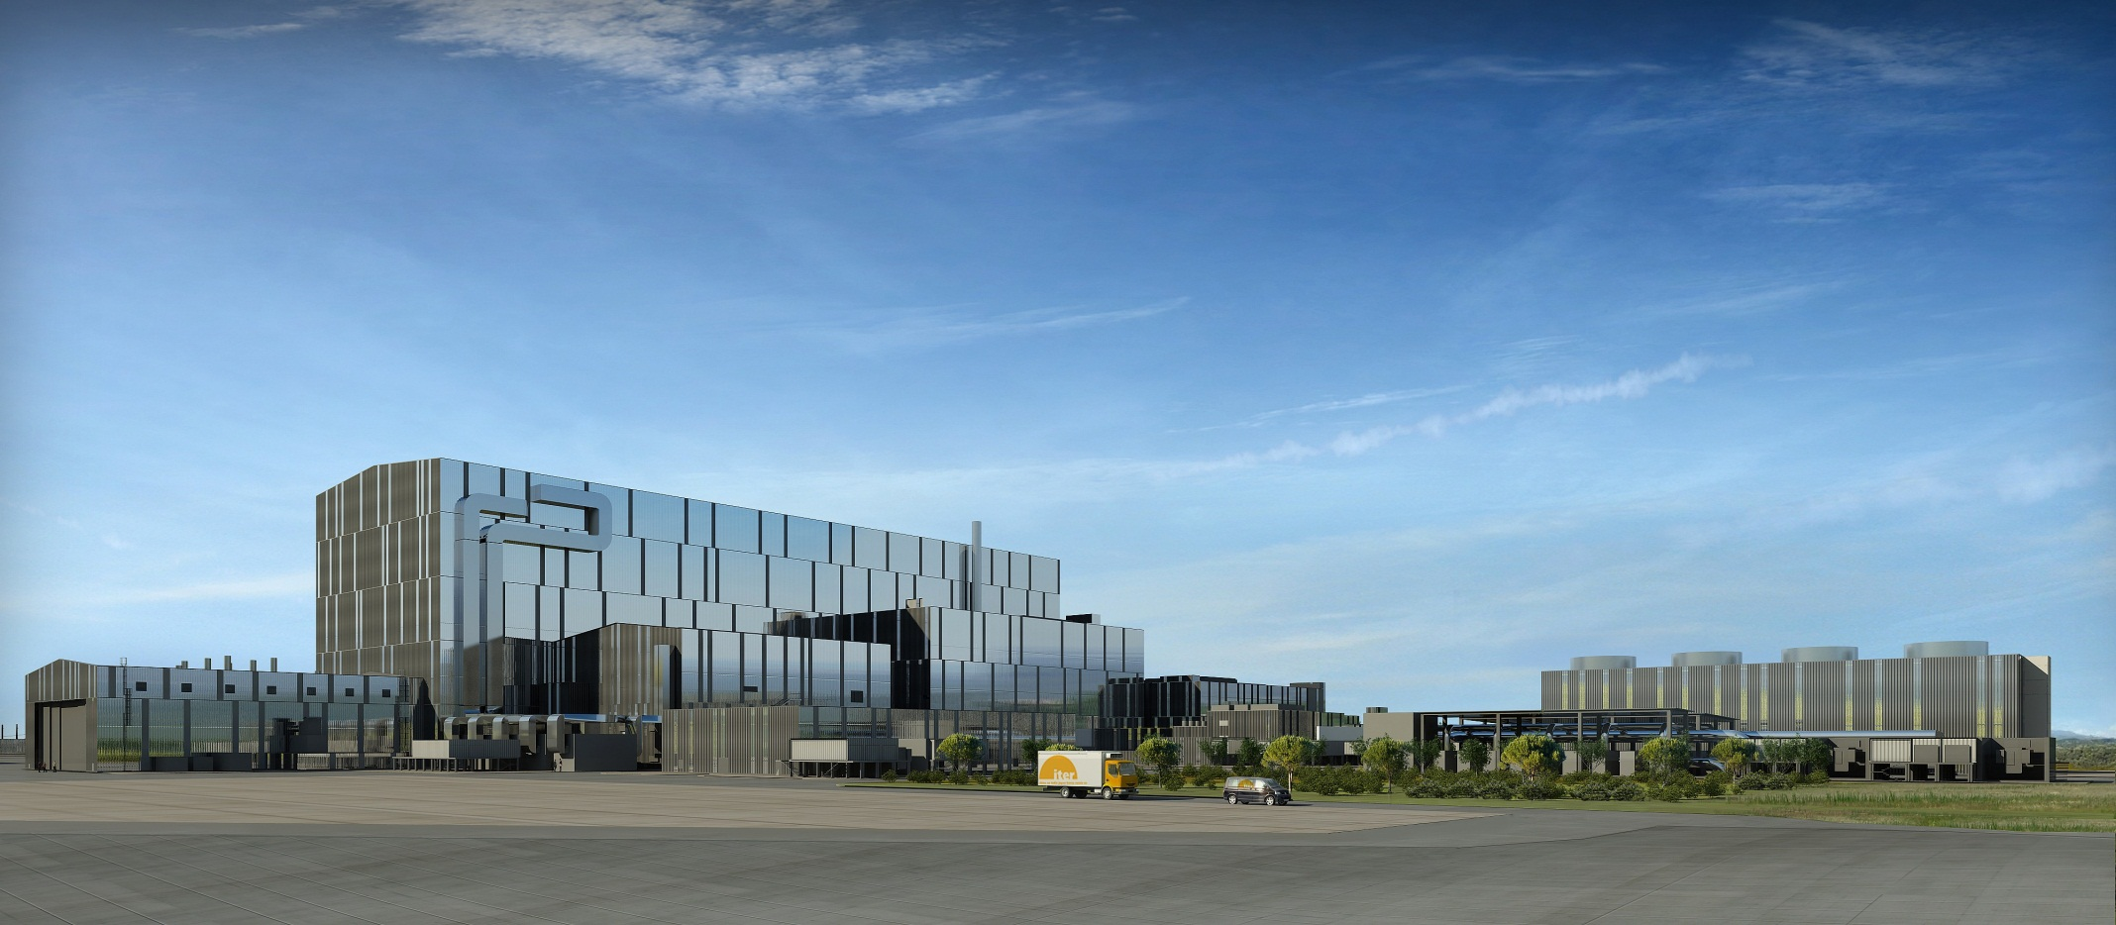
ITER Integrated Modelling Programme
SD Pinches on behalf of contributors to IM Programme
ITER Organization
The views and opinions expressed herein do not necessarily reflect those of the ITER Organization

Slide 2
Overview of IM Progress
Transitioned from Conceptual Design to implementation
  Prototype Integrated Modelling & Analysis Suite installed on ITER’s HPC Cluster
Rules & Guidelines governing Data Model extensively reviewed, refined and agreed (v2.0)
  Externally and internally (POP & Data Model Working Group)
First workflows created using IMAS
  Focused around Plasma Simulator
Progressed coupling of Plasma Simulator (IMAS) and Plasma Control System Simulation Platform (Simulink)

Slide 3
ITER Integrated Modelling Programme
A programme on integrated modelling and control of fusion plasmas, including benchmarking and validation activities, co-ordinated by the ITER Organization, but developed using relevant expertise within the Members’ fusion programmes
Overall aims of programme are to meet initial needs of ITER Project for more accurate predictions of ITER fusion performance and for efficient control of ITER plasmas, to support the preparation for ITER operation and, in the longer term, to provide the modelling and control tools required for the ITER exploitation phase
Endorsed by 1st ITER Council, November 2007

Slide 4
ITER Integrated Modelling Programme
Two primary functions to aid planning and executing ITER Research Plan
  Support Plasma Operations
  Support Plasma Research
Successful development and implementation requires:
  Close collaboration across Directorates within ITER Organization
  Close collaboration between ITER Organization and ITER Members’ domestic fusion programmes

Slide 5
Supporting Plasma Operations
Requires physics modelling tools for:
  Validation of pulses prior to operation
  During shots for plasma control (forecasting) and live display
  Post-pulse for comprehensive reconstruction using full set of diagnostic measurements
Tools must be computationally efficient, robust, well-documented and interface with other systems
  Must be validated and have associated regressions tests
Managed by IO and accessible to ITER Members
Describe macroscopic behaviour that improves as ITER explores new physics domain of burning plasmas
Integrated Modelling & Analysis Suite (IMAS)

Slide 6
Integrated Modelling & Analysis Suite (IMAS)
ITER Physics Data Model
  Used for both experimental (all devices) and simulation data
Physics Codes
  To support Plasma Operations and Plasma Research
  Contributed and validated by ITER Members
Workflow Engine
  To orchestrate execution of integrated modelling workflows
Framework
Physics codes
Access layer
Data Model
Data Model
Data Storage

Slide 7
ITER Physics Data Model
Used between physics codes and from/to storage
Data Dictionary defines structuring and naming of data
  Rules & Guidelines agreed following internal/external review (v2.0)
  Uses a tree structure (allows re-use of names)
  Automated definition of data structures for all supported languages
    C/C++, Fortran, Java, Python, Matlab and IDL
Interface Data Structures (IDS = CPO in ITM-speak)
  Standardised entities for use between physics components
    E.g. Diagnostic, heating system, equilibrium, core plasma profiles
  Contains traceability (provenance) and self-description information

Slide 8
Supporting Plasma Research
Requires much more extensive set of modelling tools to be used both prior to operation and post-operation
  Examination of microscopic behaviour
  Investigation of more rigorous theoretical or computational behaviour
  Exploration of new physics
Primary basis for model improvement and validation
Applied to selected shots, segments or time-slices
Will often require significant high performance computing (HPC) facilities
Emphasis on incorporating these development components during construction of IMAS

Slide 9
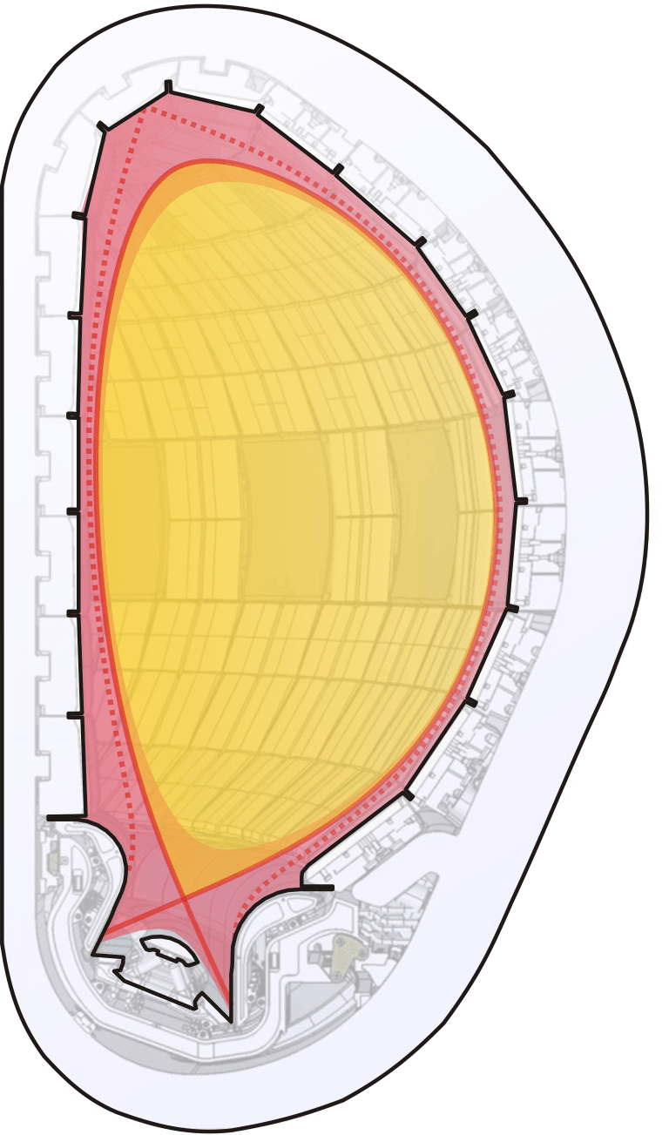
Physics Integration Challenges
Legend
Legend
Magnetic surface features
Magnetic surface features
Plasma on closed flux surfaces
Plasma on closed flux surfaces
Plasma on open flux surfaces
Plasma on open flux surfaces
Limiting material surfaces
Limiting material surfaces
Will ultimately require:
  Coupling of all spatial plasma domains (core, edge, scrape-off layer & divertor)
  Dynamic coupling of individual physics models relevant to each domain
  Interaction between plasma and PFCs
  Coupling of plasma with external circuits, H&CD, fuelling, pumping and other systems to confine and control plasma
Scrape-off
layer (SOL)
Edge
Edge
Edge
Edge
(closed gridded
(closed gridded
(closed gridded
(closed gridded
region)
region)
region)
region)
Core
Separatrix surface
Core
Core
Core
Inside: closed field lines
(grid suppressed)
Inside: closed field lines
(grid suppressed)
(grid suppressed)
(grid suppressed)
Outside: open field lines
Outside: open field lines
ρ
ρ
ρ
o
Chamber
o
o
o
Magnetic axis
Magnetic axis
Magnetic axis
Magnetic axis
wall
(O
(O
(O
(O
-
-
-
-
point)
point)
point)
point)
Poloidal
Poloidal
field
Poloidal
Poloidal
null (X
null (X
-
null (X
-
point)
null (X
-
-
point)
point)
Private flux
Inner divertor target
Divertor
Outer divertor target
Divertor dome
Divertor dome
Divertor dome
Divertor dome

Slide 10
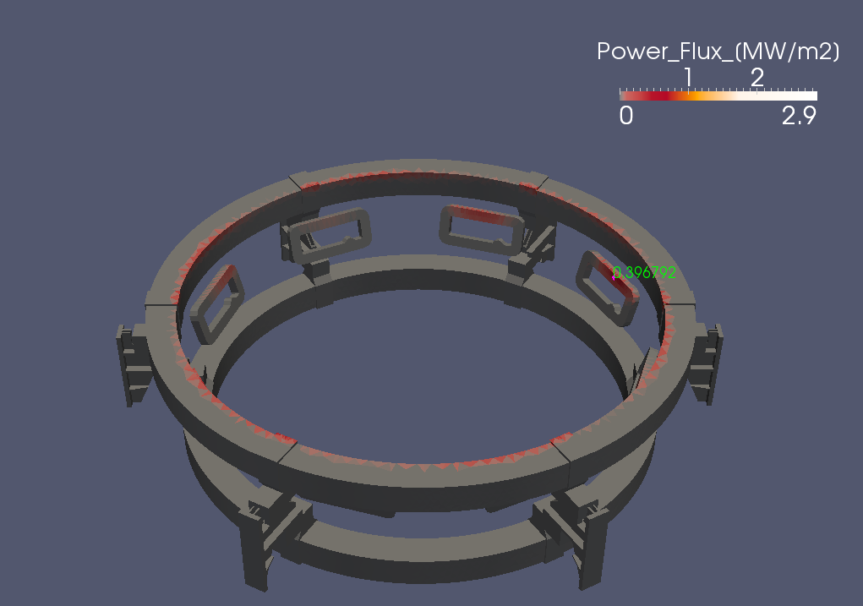
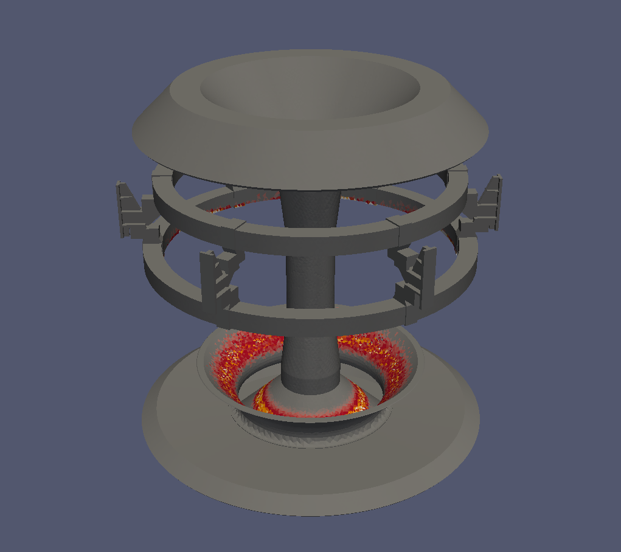
Computational Challenges
Explore new algorithms and techniques as hardware evolves
  Re-examine traditional approaches
Exploit advances in architecture
  E.g. Speed-up ×50 over single core by using GPU to follow fast ions
  → ×200 using four GPU cards
Separate machine data from physics codes
  Use Data Model to access machine/engineering/CAD data
    Improved portability
Validate physics codes towards use in engineering calculations
NBI power load in MAST Upgrade
ELM coils
PF coils
R. Akers CCFE, UK
Divertor

Slide 11
IMAS Plasma Simulator
Initial application for prototyping IM infrastructure and developing tools required for pulse preparation
Co-simulations of Plasma Simulator and Plasma Control System Simulation Platform
  Basis for pulse validation
  Develop control strategies from
  plasma initiation to burn control
  Refine response to events
    L-H transition
    Power supply interruption
    Diagnostic degradation / failure
  Troubleshoot PCS during operations
  Coupled system can guide physics
  model development
Tokamak Plant Simulator (IMAS)
Plasma Simulator
Event Generator
Actuators
Diagnostics
SDN Simulation
SDN Simulation
PCS Simulation Platform

Slide 12
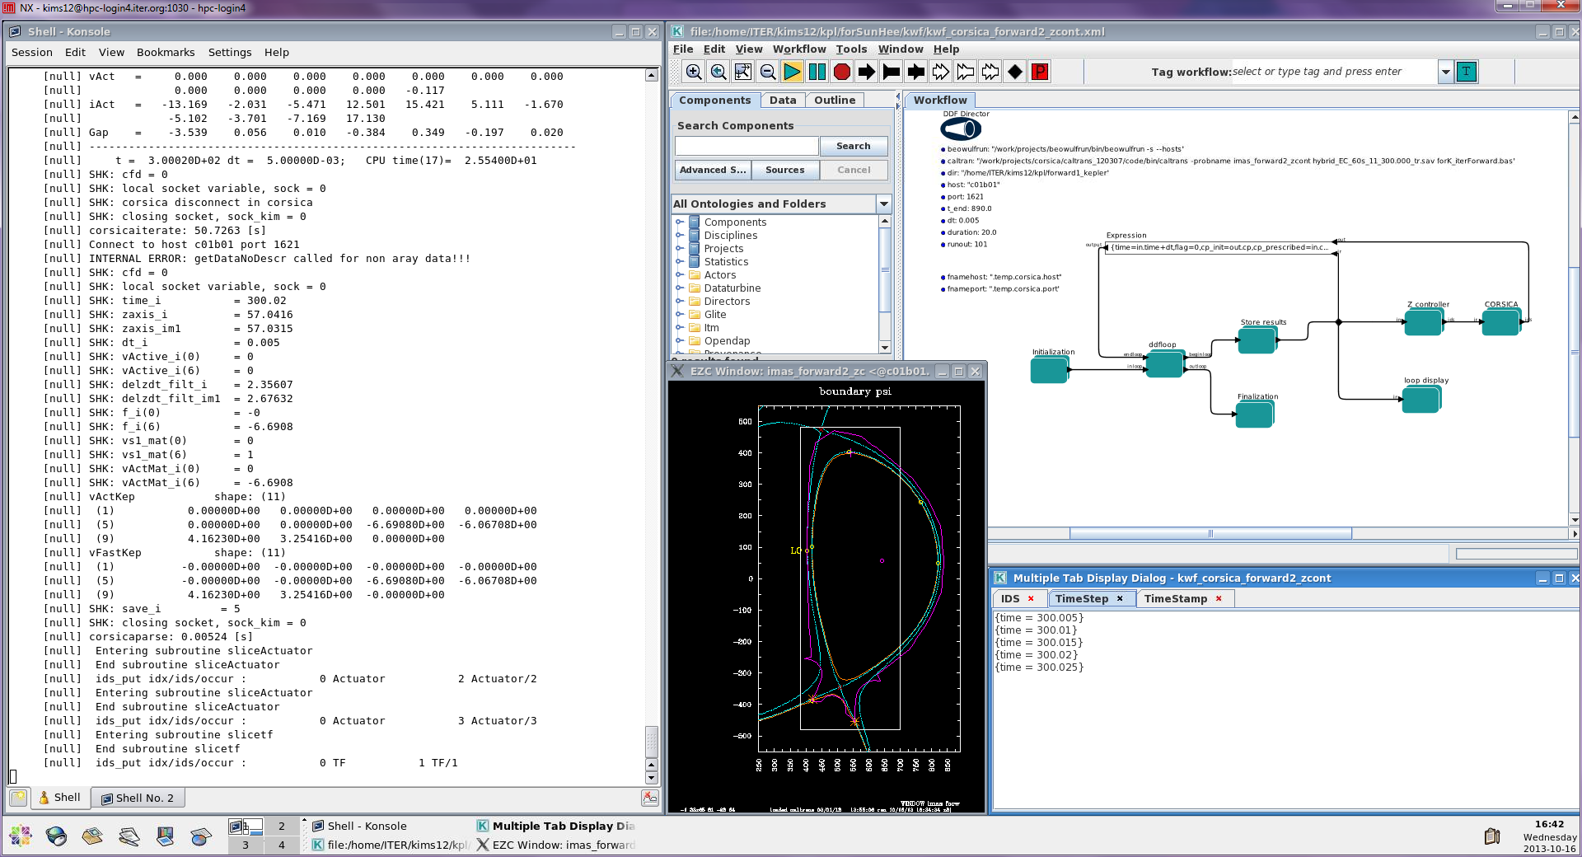
CORSICA-based Plasma Simulator
CORSICA implemented as single workflow component
Example: Free-boundary 12.5 MA hybrid scenario
  Realistic sources and external Z controller
Kepler workflow engine
Z controller
Z position
PF I & V
CORSICA
Text output
Graphical output
M Hosokawa, S H Kim, T Casper & LLNL CORSICA colleagues

Slide 13
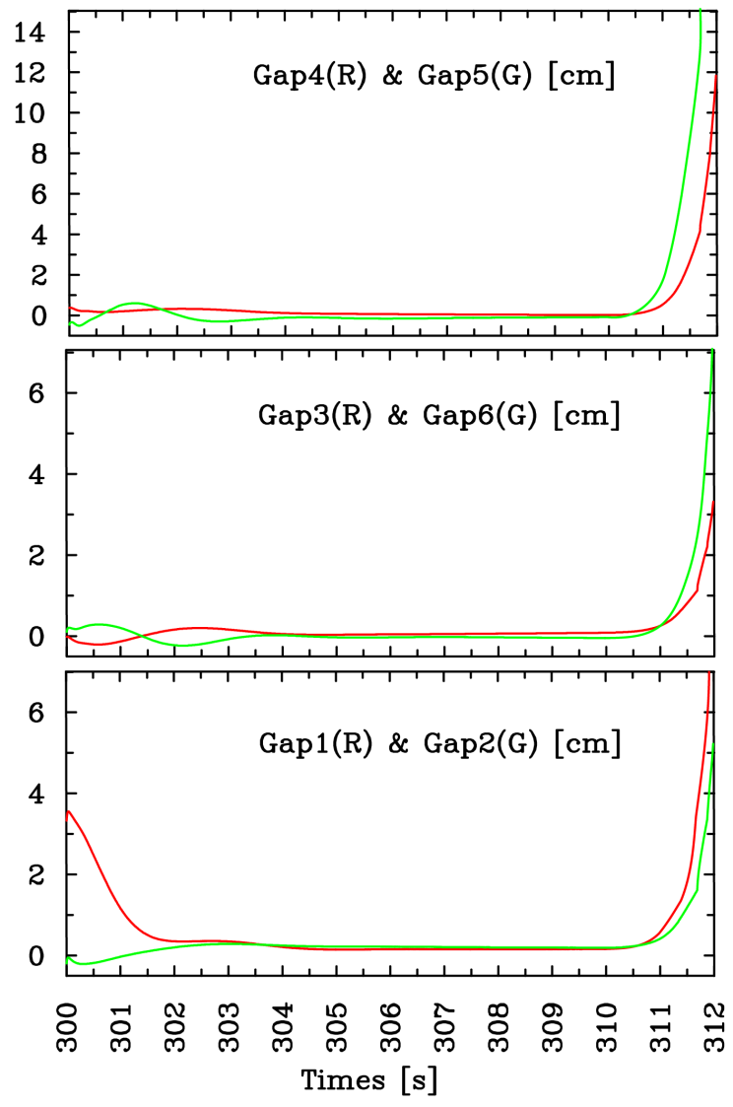
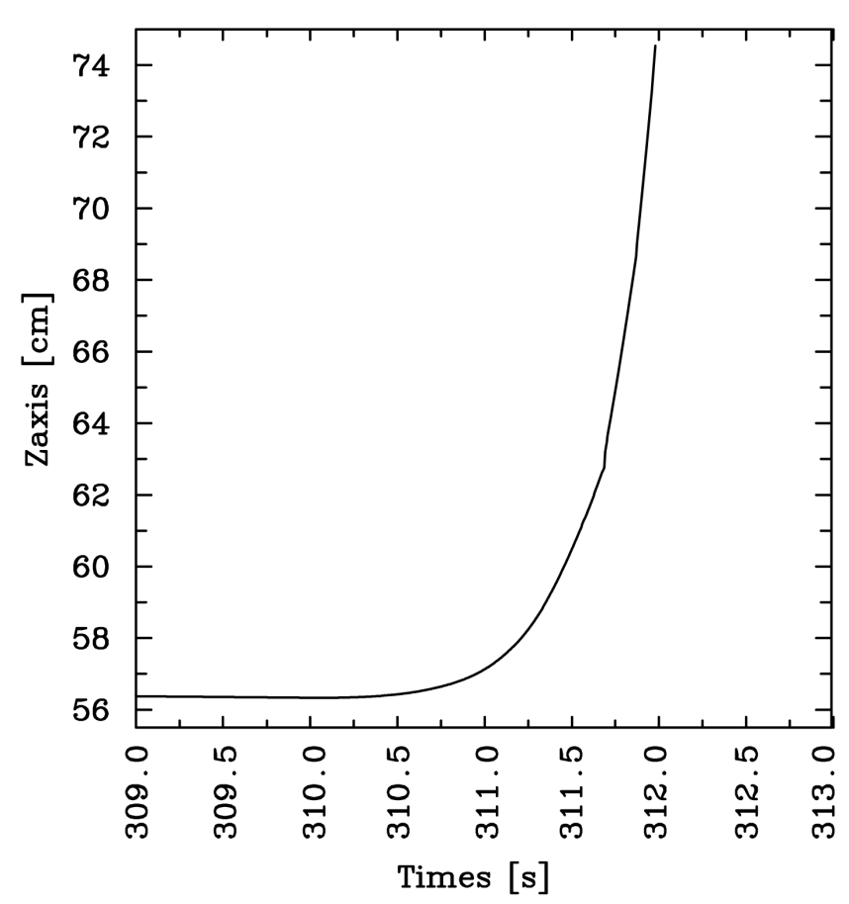
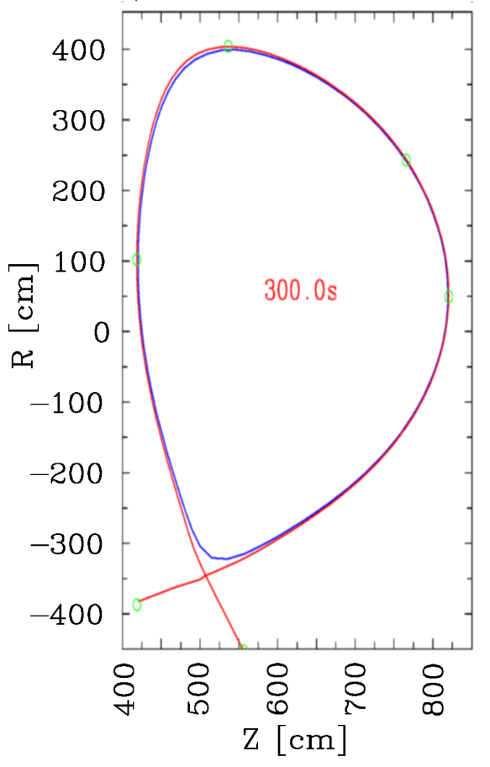
CORSICA-based PS: Free-boundary plasma evolution with external Z controller
VDE triggered at 310s by switching off feedback
G5
G4
G6
G3
G1
G2
M Hosokawa, S H Kim, T Casper & LLNL CORSICA colleagues

Slide 14
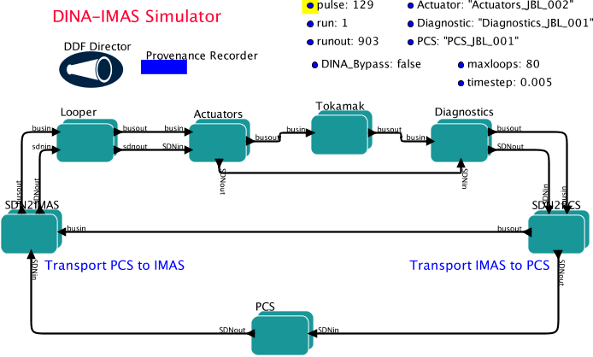
DINA-based Plasma Simulator
DINA integrated into IMAS in modular fashion
J Lister, V Lukash, R Khayrutdinov and DINA colleagues

Slide 15
Status of ITER Integrated Modelling & Analysis Suite
Prototype IMAS Framework now running on ITER’s HPC cluster
  Physics Data Model
    IDSs for many of initial workflows (v1.0)
    Revised set of Rules & Guidelines for Data Dictionary agreed (v2.0)
  First workflows based on integrating ITER’s existing physics codes
    CORSICA-based Plasma Simulator
      Uses v1.0 of DM
    DINA-based Plasma Simulator
      Uses v2.0a of DM
  Workflow engine (Kepler) and UAL
  Revision control (Git) and issue tracking (JIRA) for all components

Slide 16
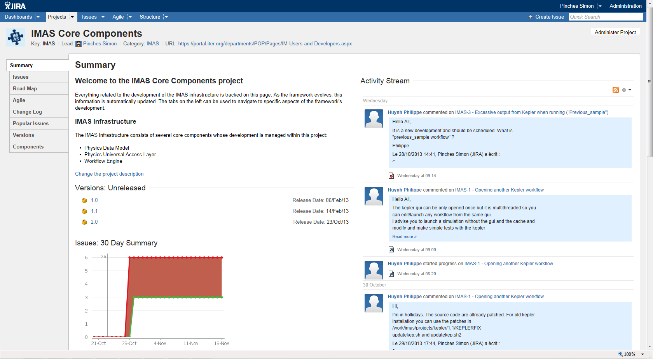
JIRA used for issue tracking
JIRA used for issue tracking across ITER project
  Links to revision control & regression testing systems
  Can reference issues in commits and automatically create links
https://jira.iter.org/browse/IMAS

Slide 17
Source Code Management
IMAS has adopted a distributed revision control system (Git)
  Allows simultaneous independent development within IO and Members
  No single master version
    ITER master version held at IO
    Member master version within Member, etc.
  Can be linked to existing Subversion repositories if necessary
  Can use submodules to embed codes within codes
    E.g. Kepler within IMAS Core; B2 and EIRENE within SOLPS
Merge requests are made to RO(s) to integrate changes
  Provides tools to transfer (selected) changes between repositories
Changes can be reviewed and merged (or rejected)
  Source code review

Slide 18
Regression Tests and Code Validation
Writing regression tests is a necessity
  Part of acceptance criteria
  Responsibility of code developers to keep up-to-date
    Accepting changes
Automating regression testing
  Automatically run at commit time (e.g. using Bamboo)
    Enforce passing of tests as part of modified code acceptance
      i.e. Merging code only possible if tests passed
Validate models
  Error bars in experimental measurements and simulations
  Validation metrics
  Continuous process during development

Slide 19
Next Steps: Extend and Use Data Model
Revise and approve IDSs (v2.0) to comply with new Rules & Guidelines
  ≤ July 2014
Extend Data Model using Rules & Guidelines
  In partnership with developers as needed
    Plasma Simulator; edge codes; grids; stability; fast ions
Test ITER Data Model on experimental data
  Can only be done by Members
https://portal.iter.org/departments/POP/Pages/IM-Users-and-Developers.aspx

Slide 20
Next Steps: Start to address centralised storage with remote access
Final storage solution (ITERDB) still to be established and implemented
  CODAC working towards prototype implementation
Investigate support for multiple databases exchanging data
  E.g. At IO and in Members
Consider allowing local (distributed) and centralised storage
  Local (mainly private)
    Can work offline (e.g. on laptop) but still share as appropriate
  Centrally published (shared database)
    Write directly
    Or push local results to shared storage
      If allowed: user restrictions; simulation restrictions (e.g. ITER)

Slide 21
Start Guaranteeing Reproducibility
Store information to guarantee reproducibility of simulations
  Fully linked audit trail
    Workflow and component revisions
    Input data
  Experimental analogue is Pulse Schedule and plant configuration
Could form part of publication rules
  i.e. Simulation citation sufficient to inspect workflow and recover results

Slide 22
IMAS use by wider ITER family
Encourage remote use by limited number of beta testers
  Access to IMAS installation on HPC cluster for evaluation and testing already possible
  Only limited support…
Package framework for local use within domestic programmes
  Build experience and get feedback from community
IMAS qualified through use by Members

Slide 23
Extend IMAS
Modularise existing workflows
  Support validation process through exchange of modules
Extend physics capabilities
  Integrate physics components in parallel with extension of Data Model
  Will start with activities within Plasma Operations Directorate
  Domestic programmes (including EU ITM TF) and ITPA TGs well-placed to provide guidance on choice of physics models

Slide 24
Start to use IMAS
Support tackling high priority questions for ITER (ITPA)
  Core-edge plasma treatment
  Density profile evolution
  W influx and transport
  Rotation: NBI, ELM coils, fast ion losses
Improve and validate Plasma Simulator and support development of controllers for PCS
  Basis for future pulse validation

Slide 25
Possible EU ITM TF support for IMAS
ITM has access to data (a luxury ITER does not – yet!)
  Use to qualify framework technologies and validate components
  E.g. For post-pulse analysis and predictive modelling on present machines
ITM has access to physics codes
  Use to demonstrate some genuine integrated modelling
  E.g. Pellet fuelling, transients, fast ion stability in presence of ICH, etc.
  Flagship demonstrations of integrated modelling
Align ITM framework (i.e. data model) with IMAS
  This is going to take effort…
  This is acknowledged and appreciated!

Slide 26
Summary
IMAS should not be viewed as something just for ITER
The infrastructure and tools we’re building can be of benefit to all
  ITER and domestic programmes
Can accomplish so much more by working together!
Won’t always get it right
  Data model, workflow engine, UAL, etc.
But need to start with something
Develop culture of collaboration to improve
  Lifecycles for components

Slide 27
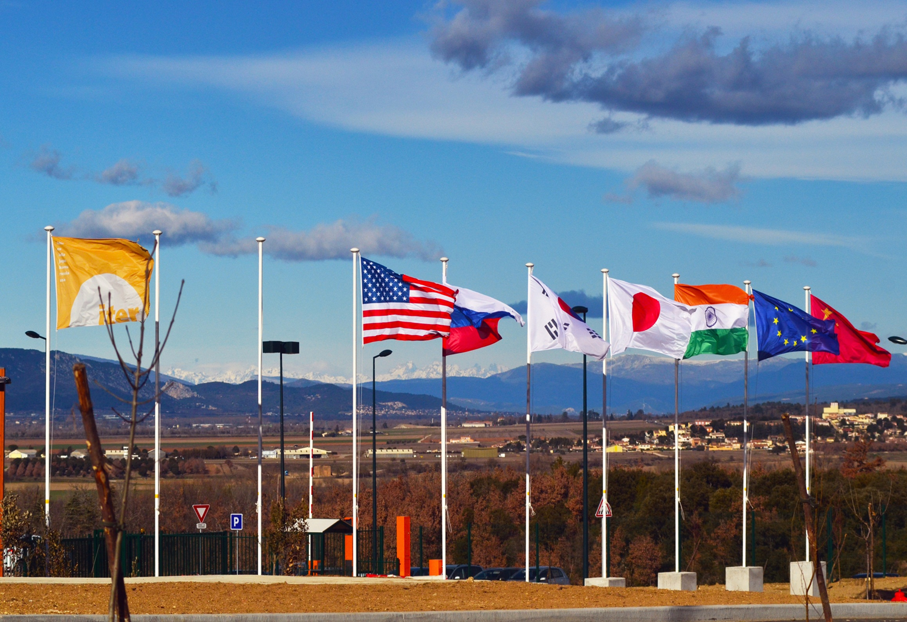

Slide 28
Highlights from Latest developments at ITER

Slide 29
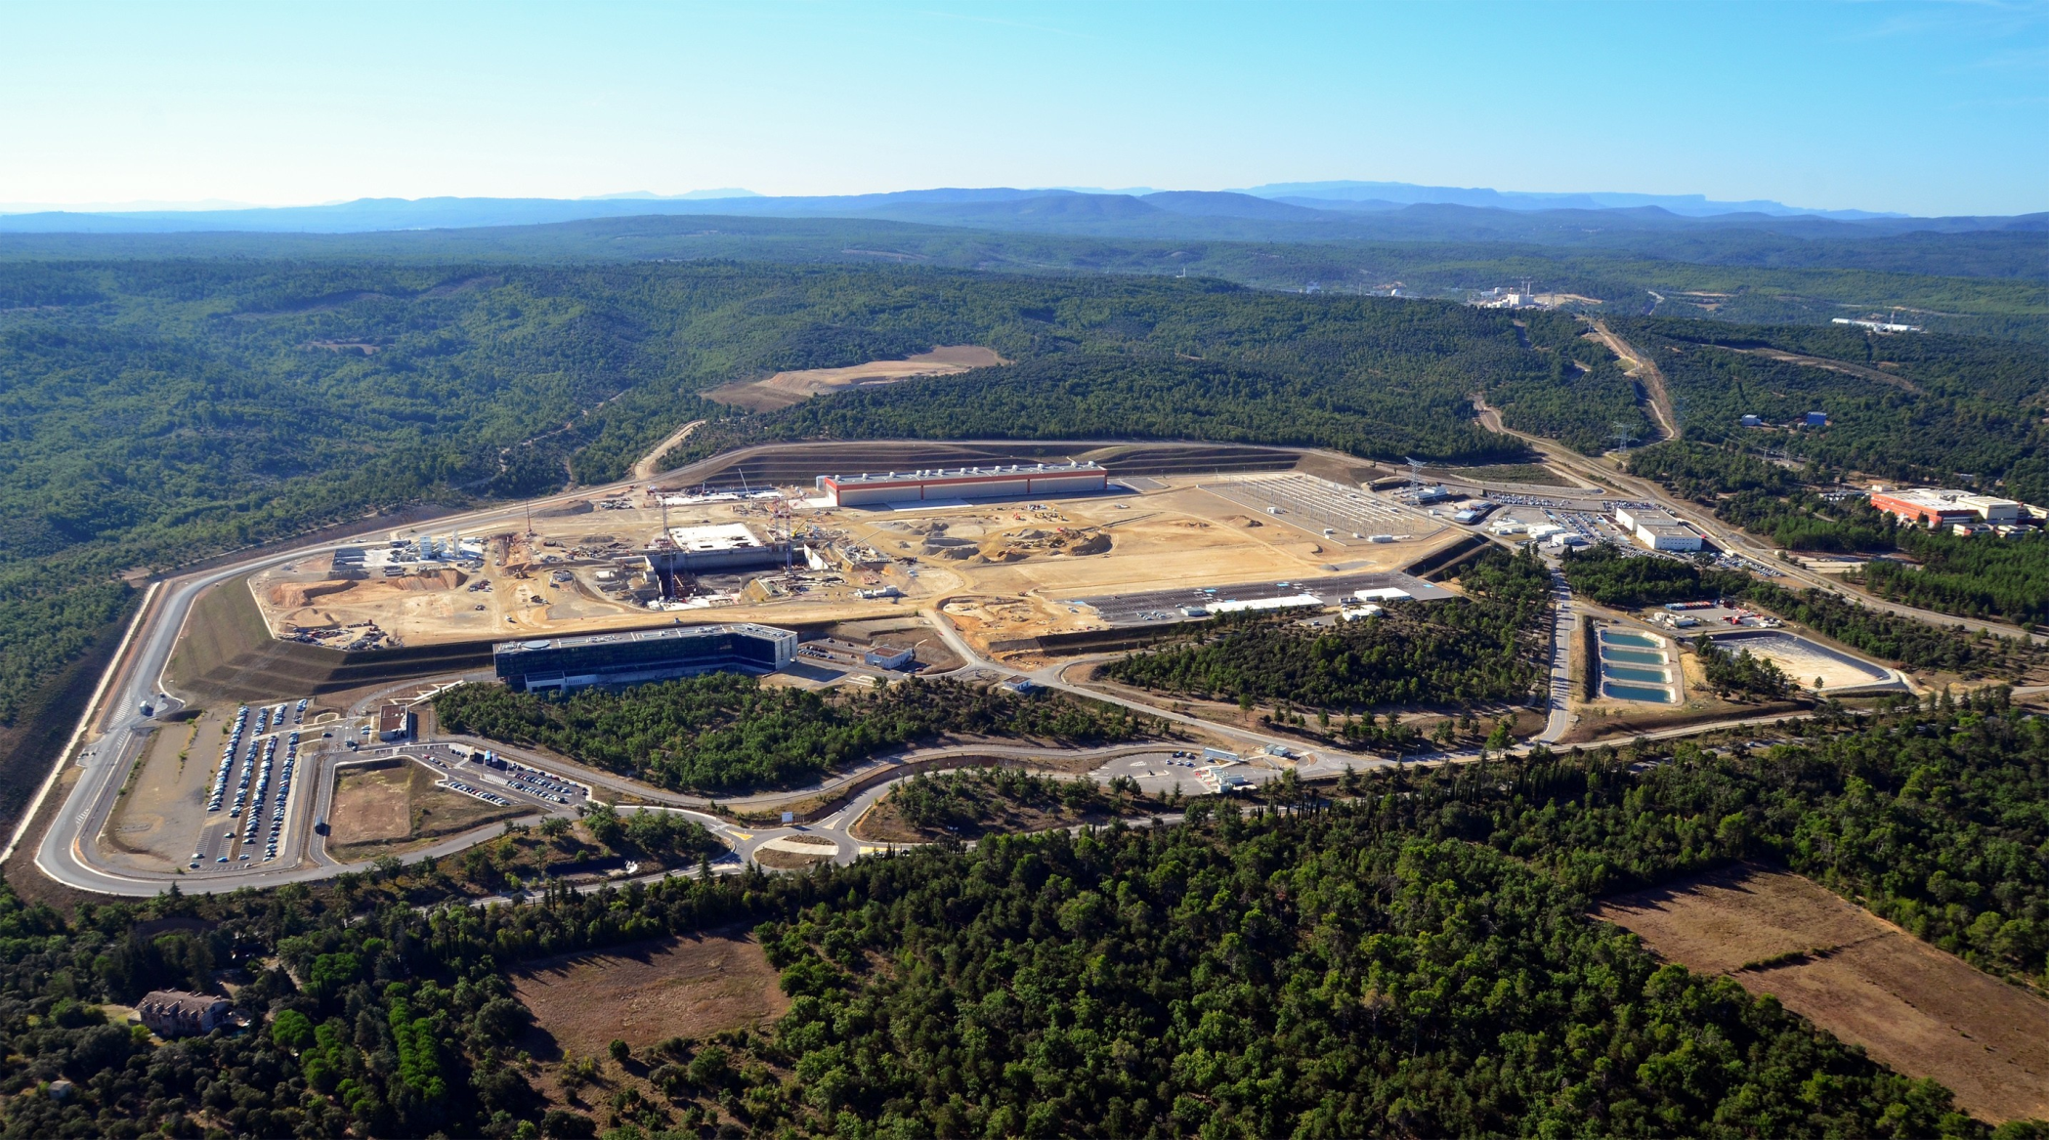
Arial Views (September 2013)

Slide 30
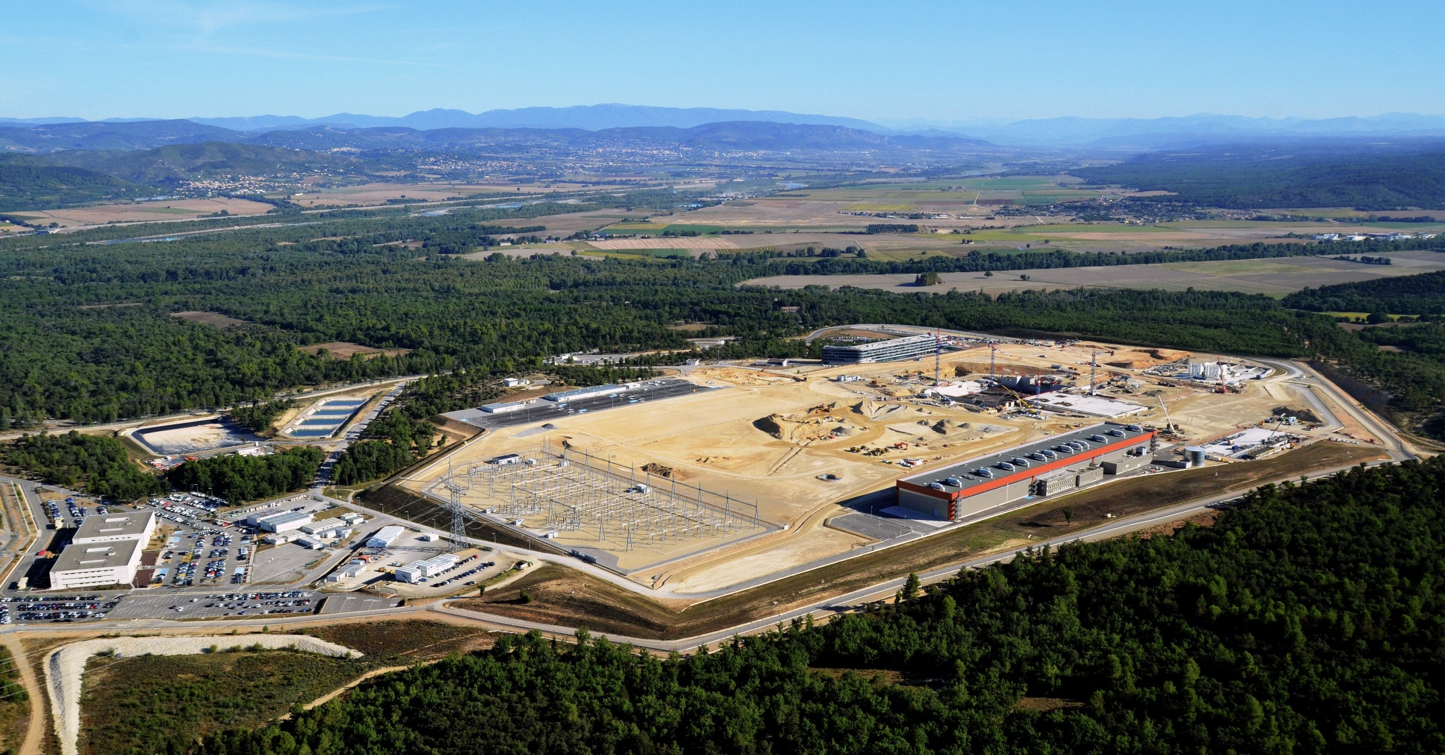
Arial Views (September 2013)

Slide 31
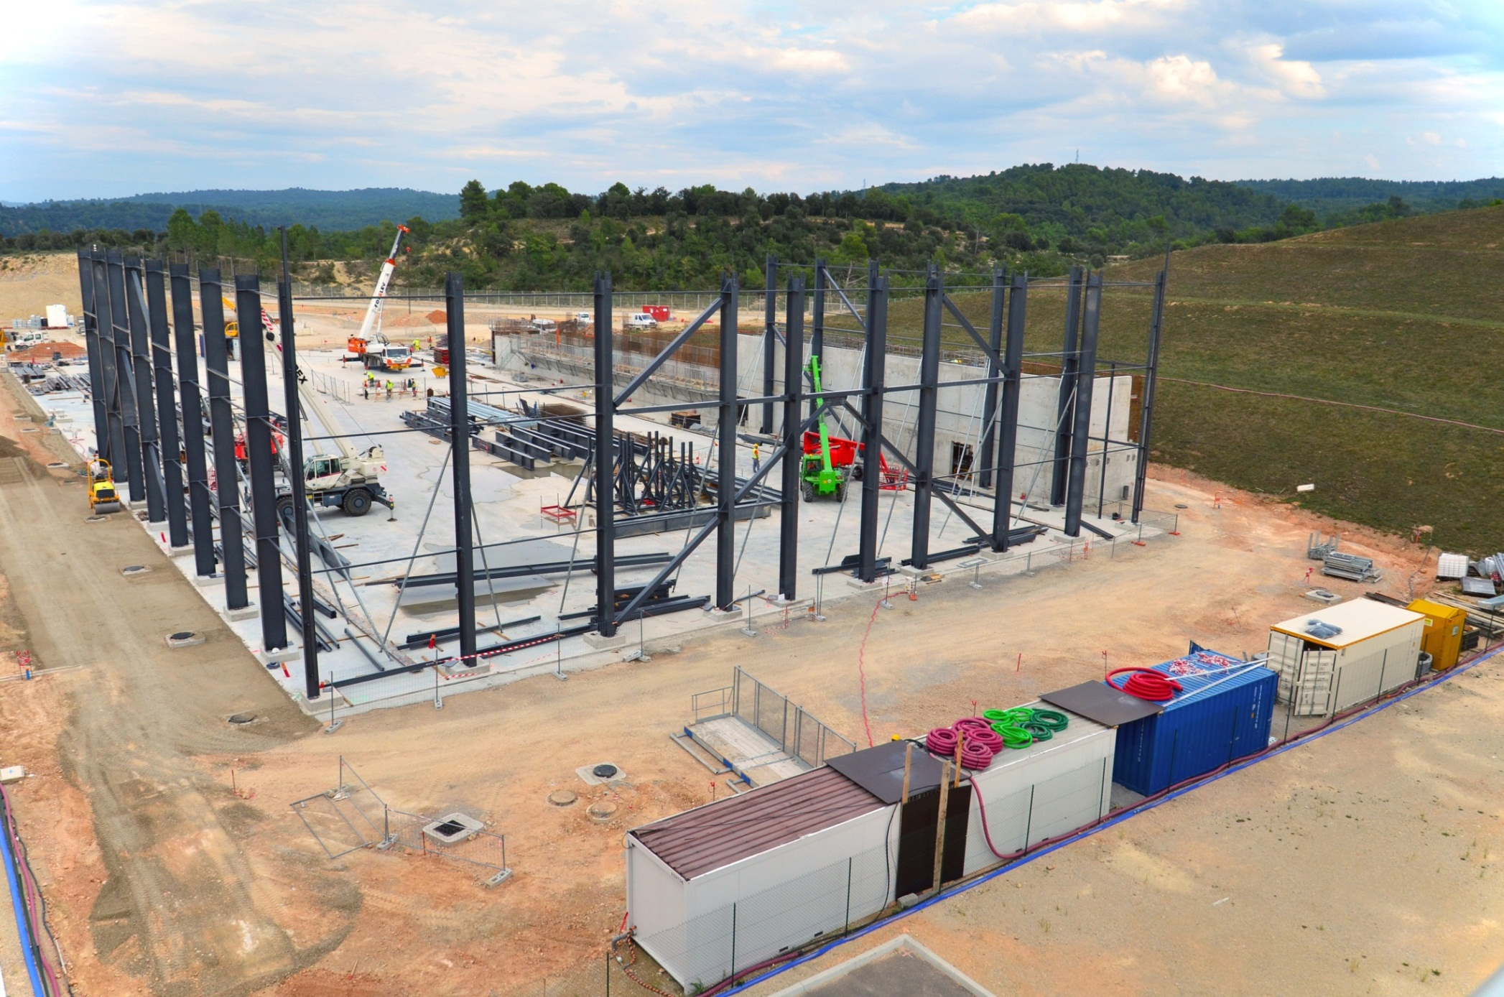
IN-DA Cryostat Workshop Foundation and Steel Structures

Slide 32
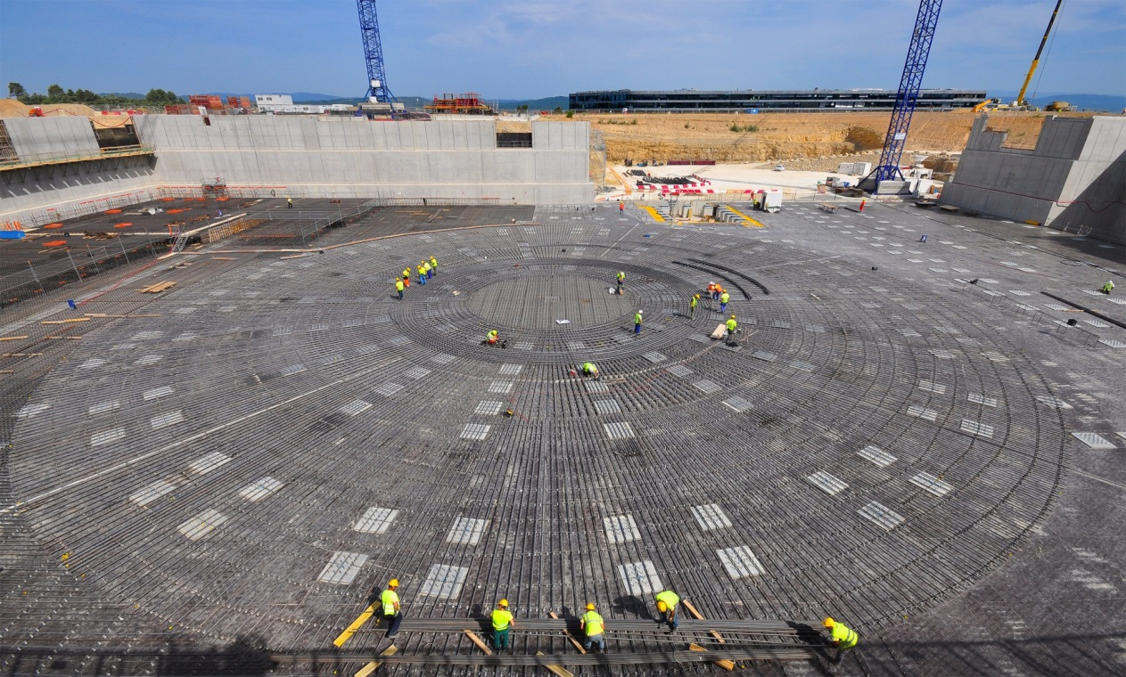
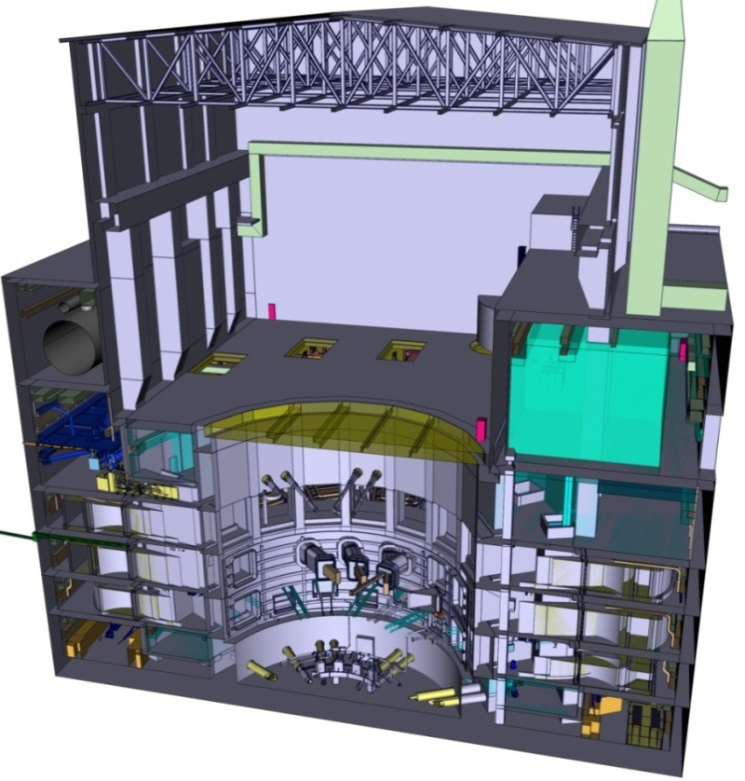

Construction of Basement of Tokamak Complex (B2 slab;TB00)
Preparation for the 1.5-metre-thick B2 slab is being finalized in the Tokamak Seismic Pit. 15,000 m³ of concrete will be poured, which—added to the weight of the rebar (~ 4,000 tonnes)—will amount to a load of some 37,500 tonnes. The B2 slab will support the 360,000-tonne Tokamak Complex. June 2013

Slide 33
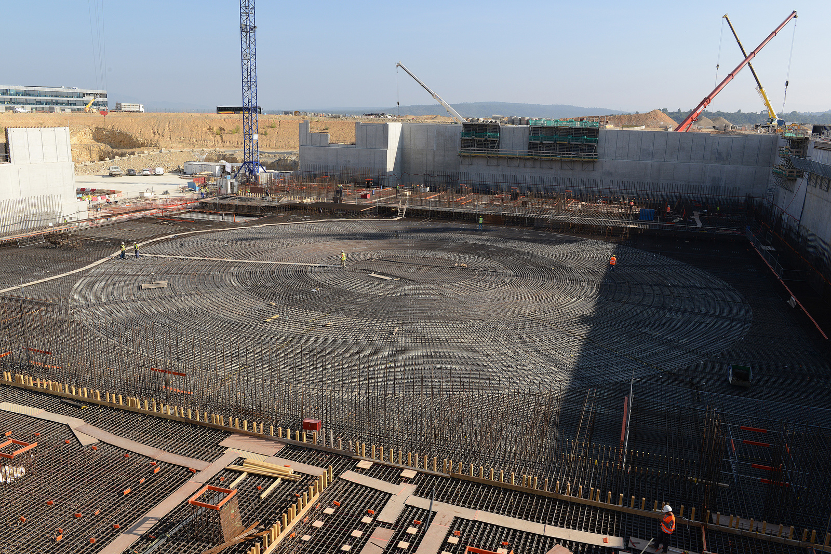
ITER Tokamak Pit (September 2013)

Slide 34
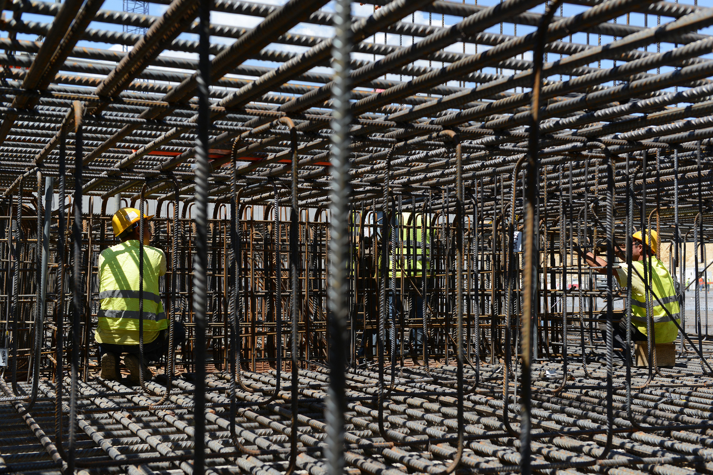
ITER B2 Slab

Slide 35
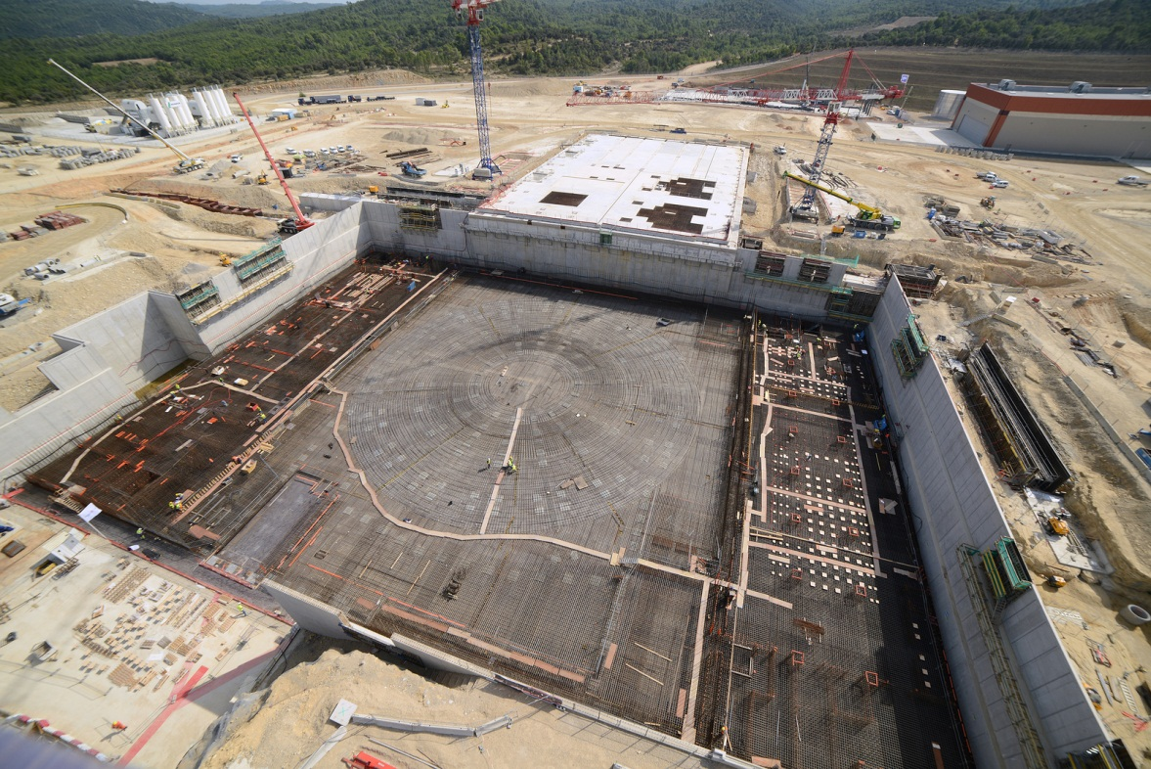
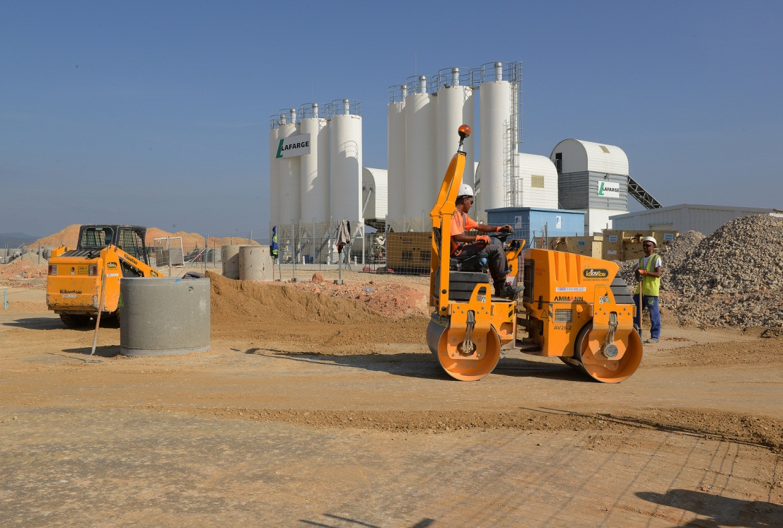
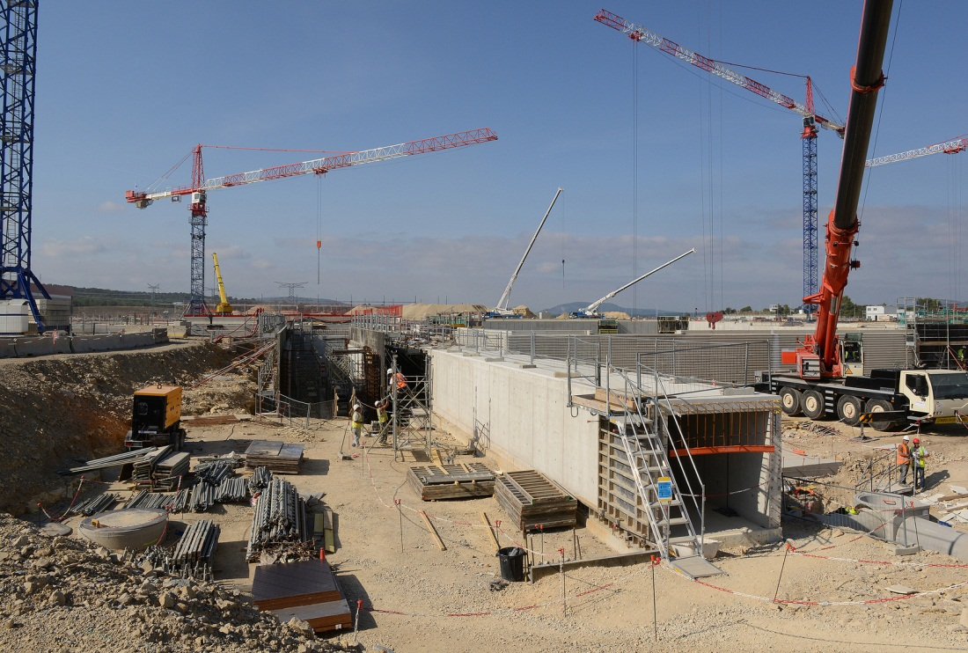
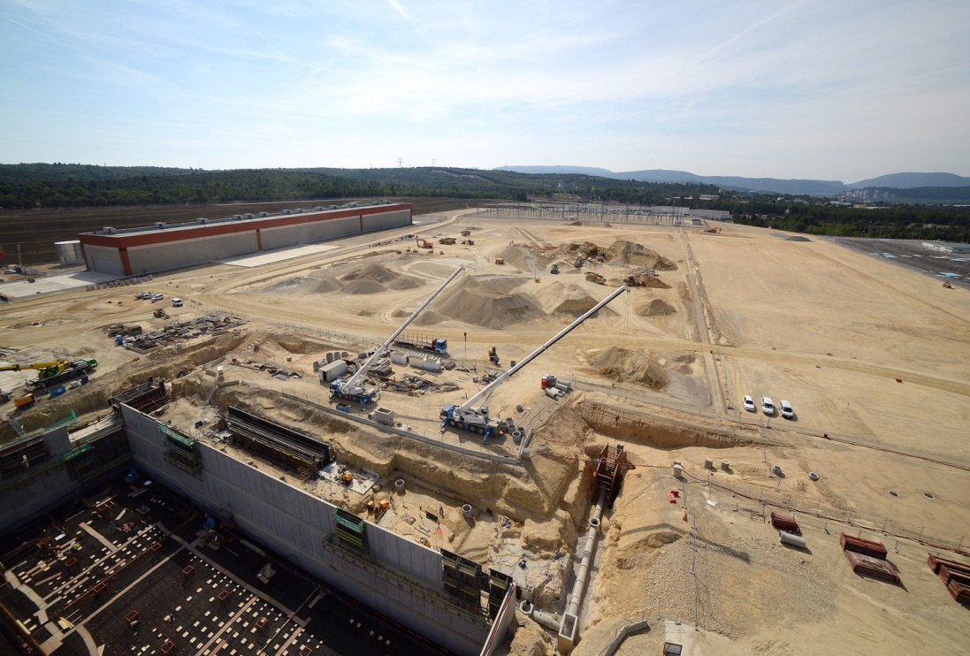
Overview of Site Progress

Slide 36
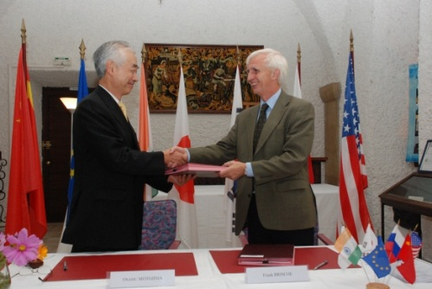
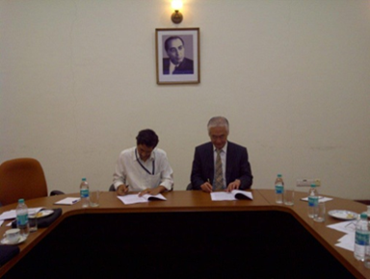
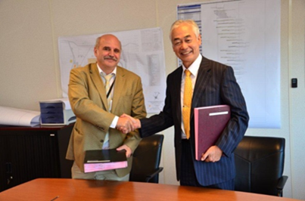
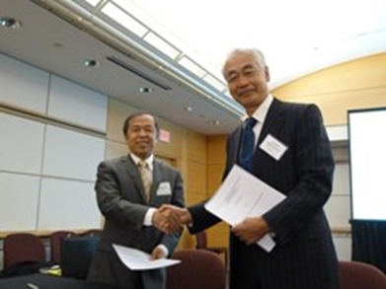
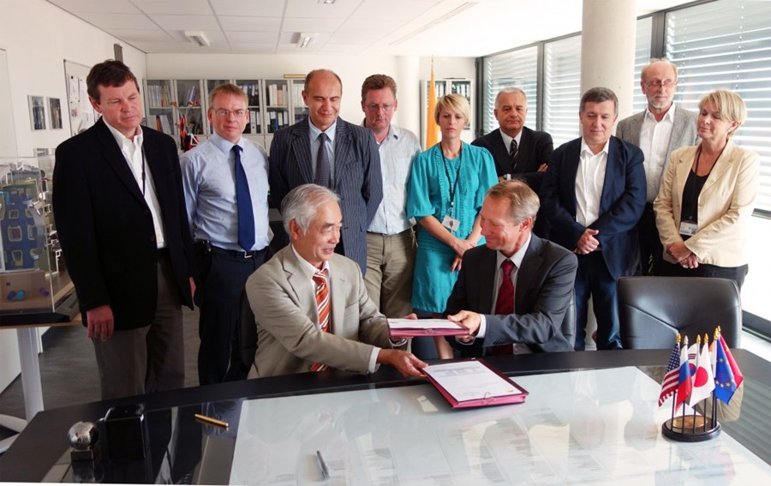
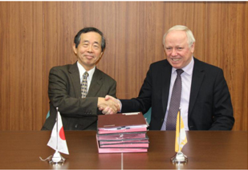
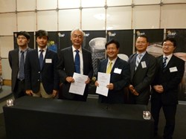
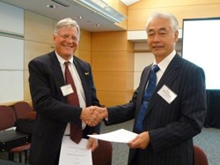
Procurement Arrangements
EU
IN
RF
CN
JA
KO
US
By end of September, 90 PAs signed out of 140; The signed value is 2413.6 kIUA, representing 83.5% of the total 2891.3 kIUA for the ITER Construction.

Slide 37
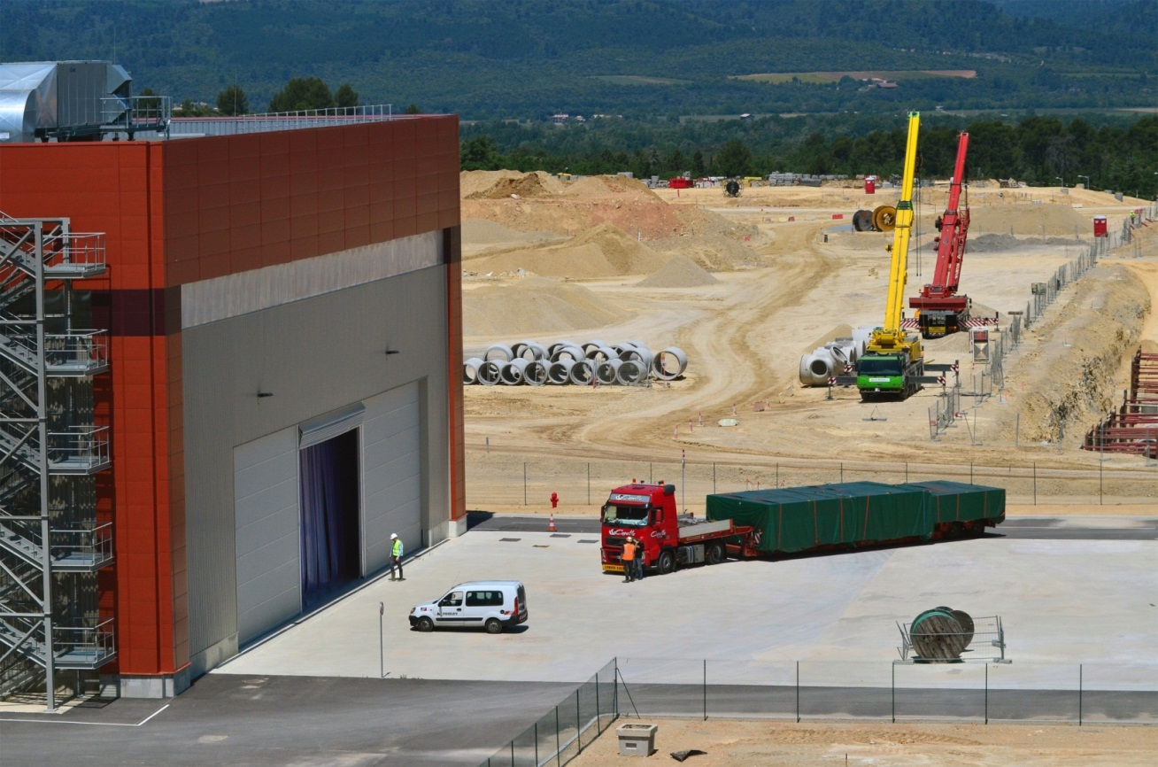
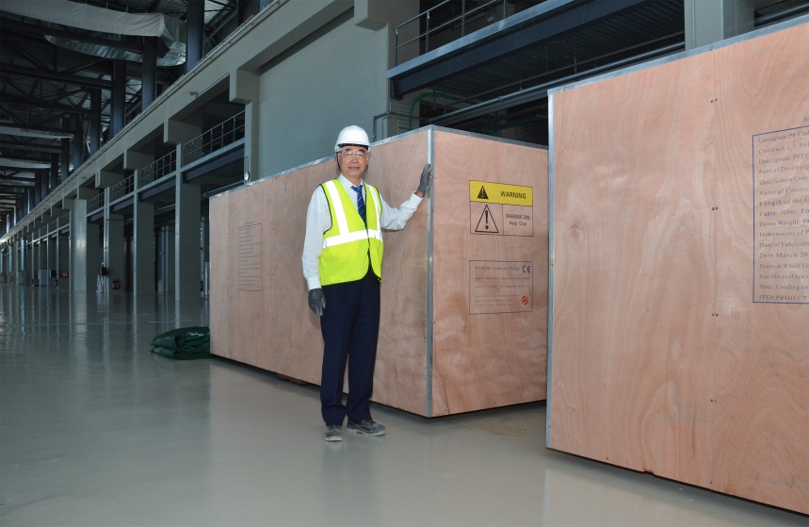

First Delivery
Three large crates, containing 737 metres of dummy conductor produced by China, were delivered to the ITER site on Monday 3 June. The conductors will be used to test the fabrication process of PF coil # 5.

Slide 38
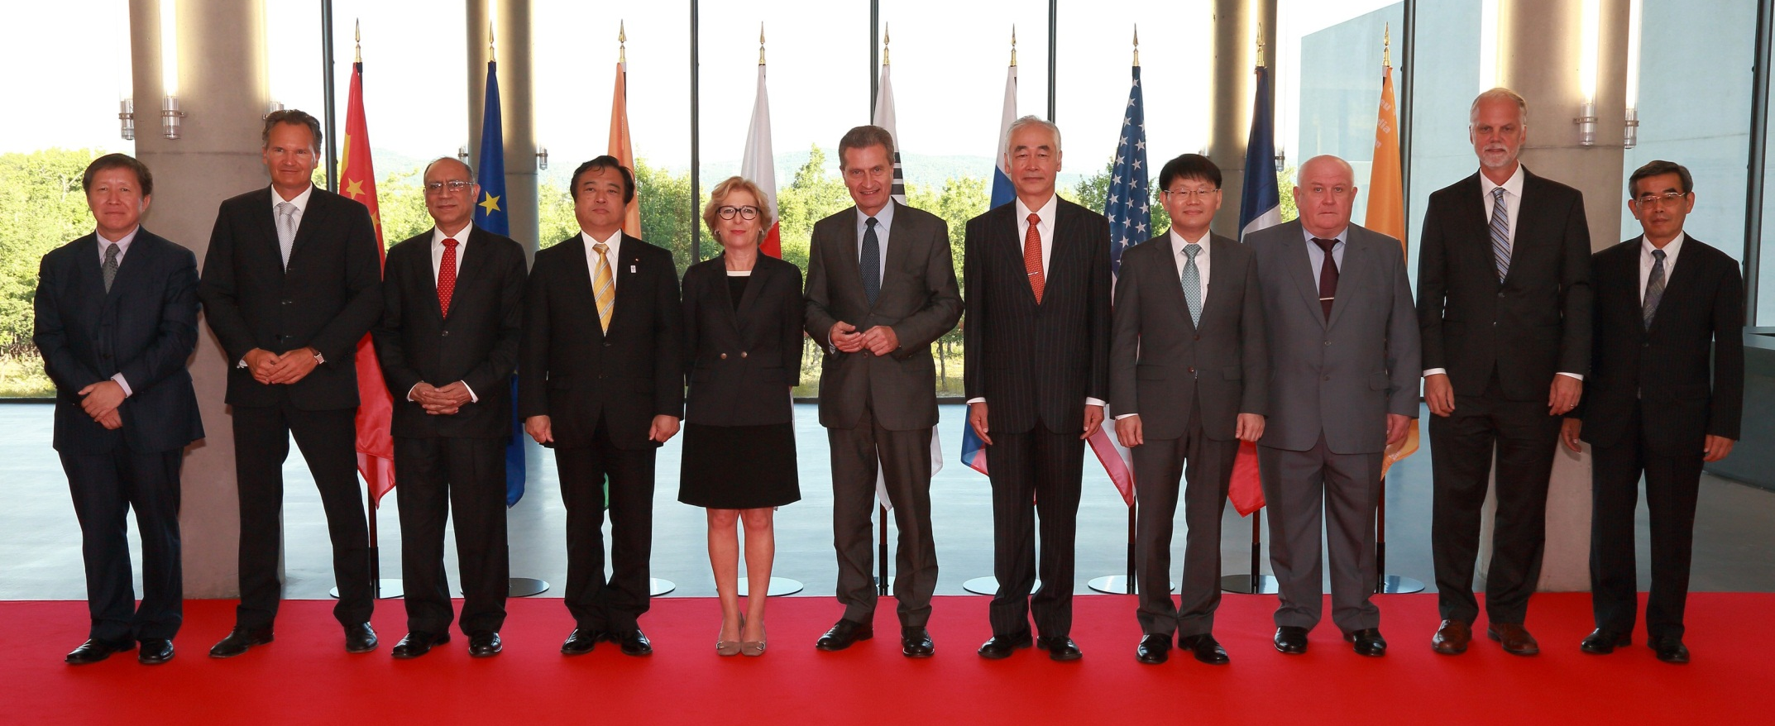
Ministerial-Level ITER Council Meeting
6th September 2013: Ministers reaffirm the importance of ITER for the world’s future energy needs

Slide 39
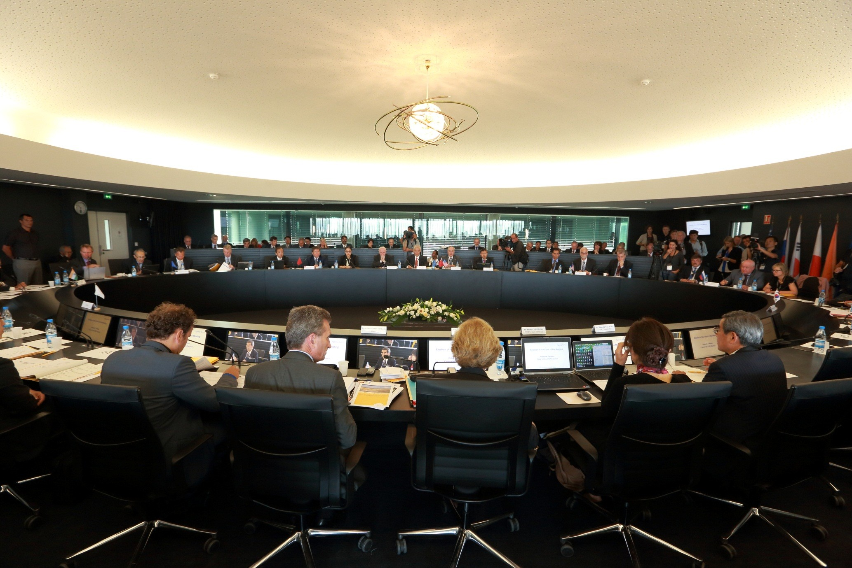
Council Chamber
Commissioner Oettinger stated: “We understand that the ITER project is a historical undertaking and that intensive effort and innovative methods will be required to meet all the challenges that still lay ahead, especially the challenge of staying within a tight but realistic schedule while containing costs.”

Slide 40
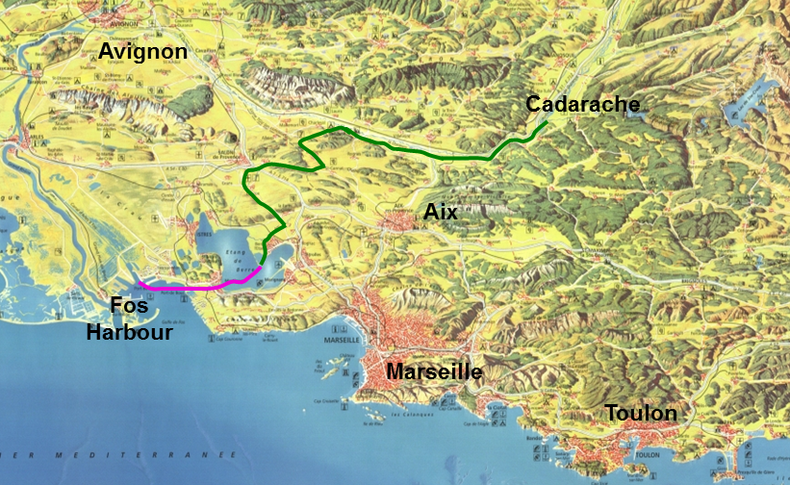
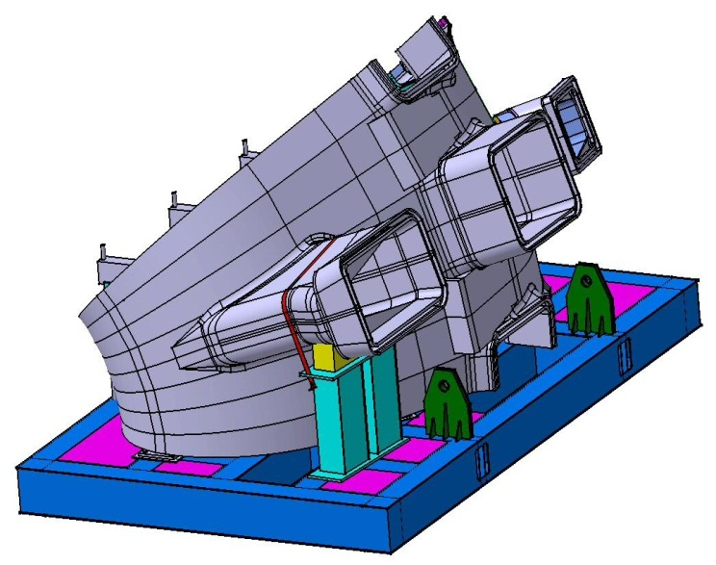
Test Convoy: 16th – 20th September 2013
The larger ITER components will arrive at the port of Marseille and be transferred by road to ITER
More than 200 ITER components are classified as Heavy Exceptional Loads (HEL)
The French state identified a suitable route (special Itinerary) from Fos Harbour to the ITER Site and from 2008 carried out the necessary new civil engineering and adaptions
There is 32 km of barging and 104 km of road transportation from Fos to ITER
The cost from Fos Harbour to ITER is largely borne by the EU with contribution from France
La Pointe Harbour
A typical HEL - VV sectors weighing 500 tons (including lifting frame)

Slide 41
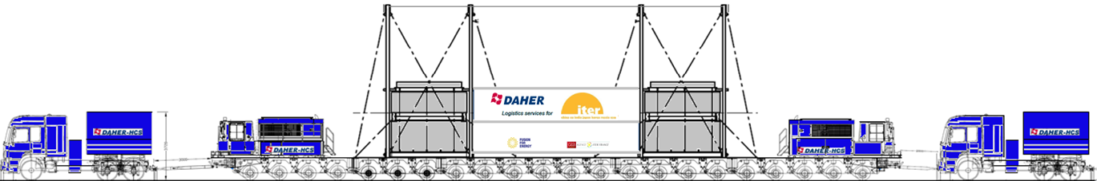

Schematic of the Mock-Up
Acceleration monitoring system (courtesy of CN-DA)
Metallic frames
Concrete blocks
Tarpaulins
Equivalent in weight to almost five 747-jets.
 | Mock-up Dimensions | Convoy Dimensions
Length : | 19 000 mm | 33 490 mm
Width | 9 000 mm | 9 000 mm
Height : | 9 100 mm | 10 250 mm
Weight : | 600 Tons | 775 Tons

Slide 42
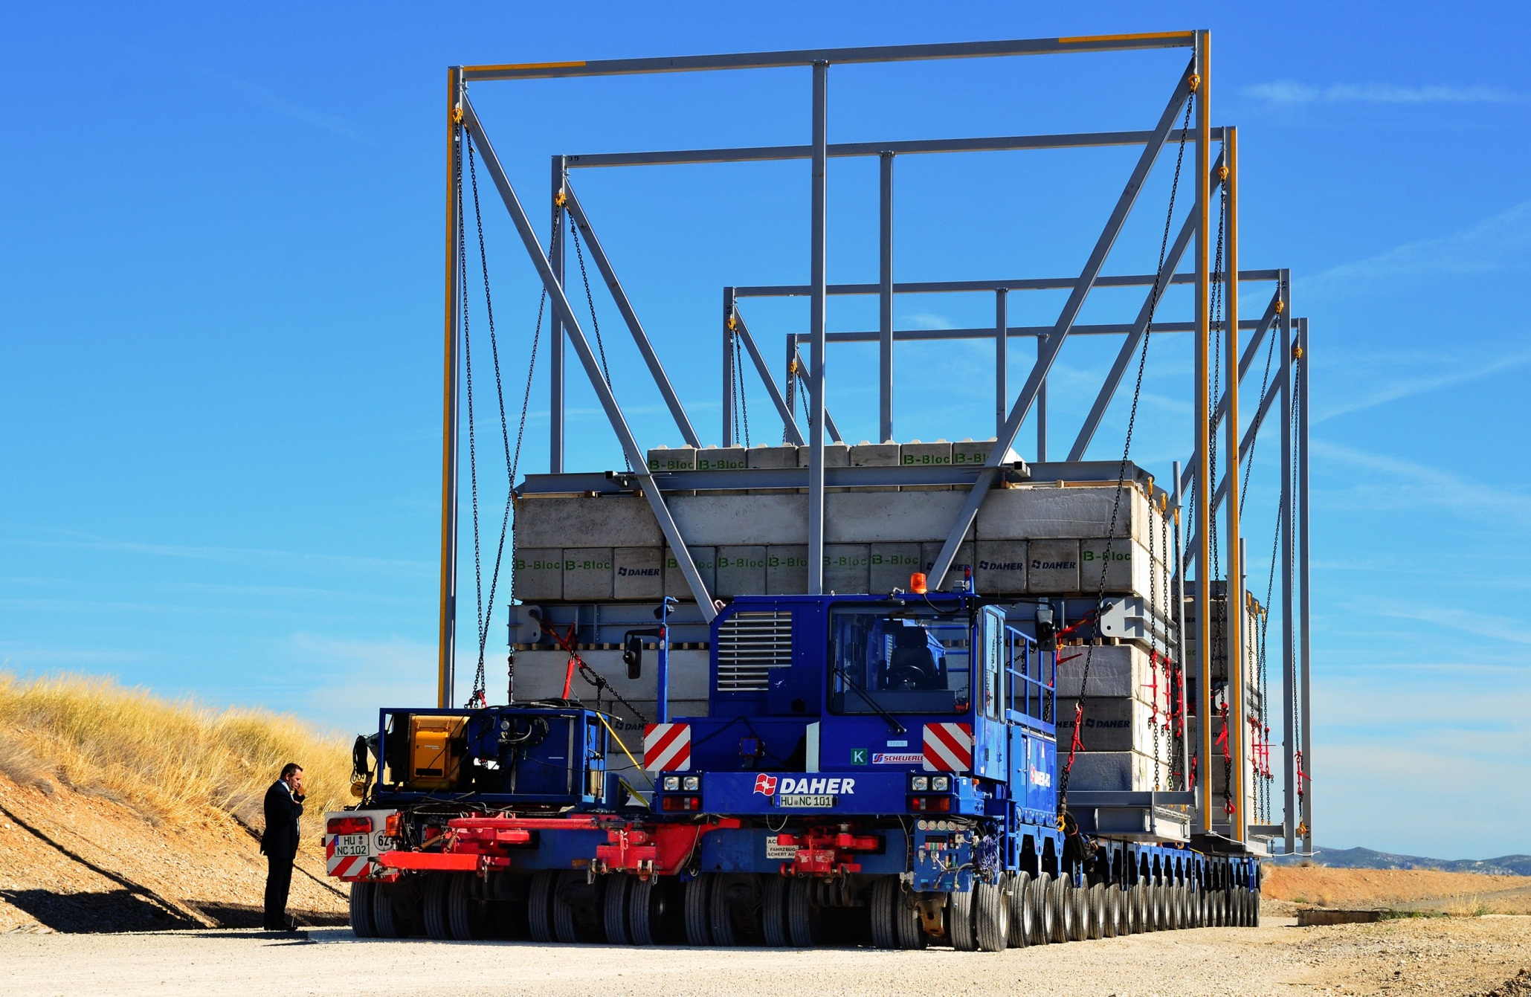
2 power generators developing 730 hp
22 axle lines
352 tyres
3.6 tonnes/m² ground pressure
Almost 47m long
9m wide
Two Control Cabins and remote control

Slide 43
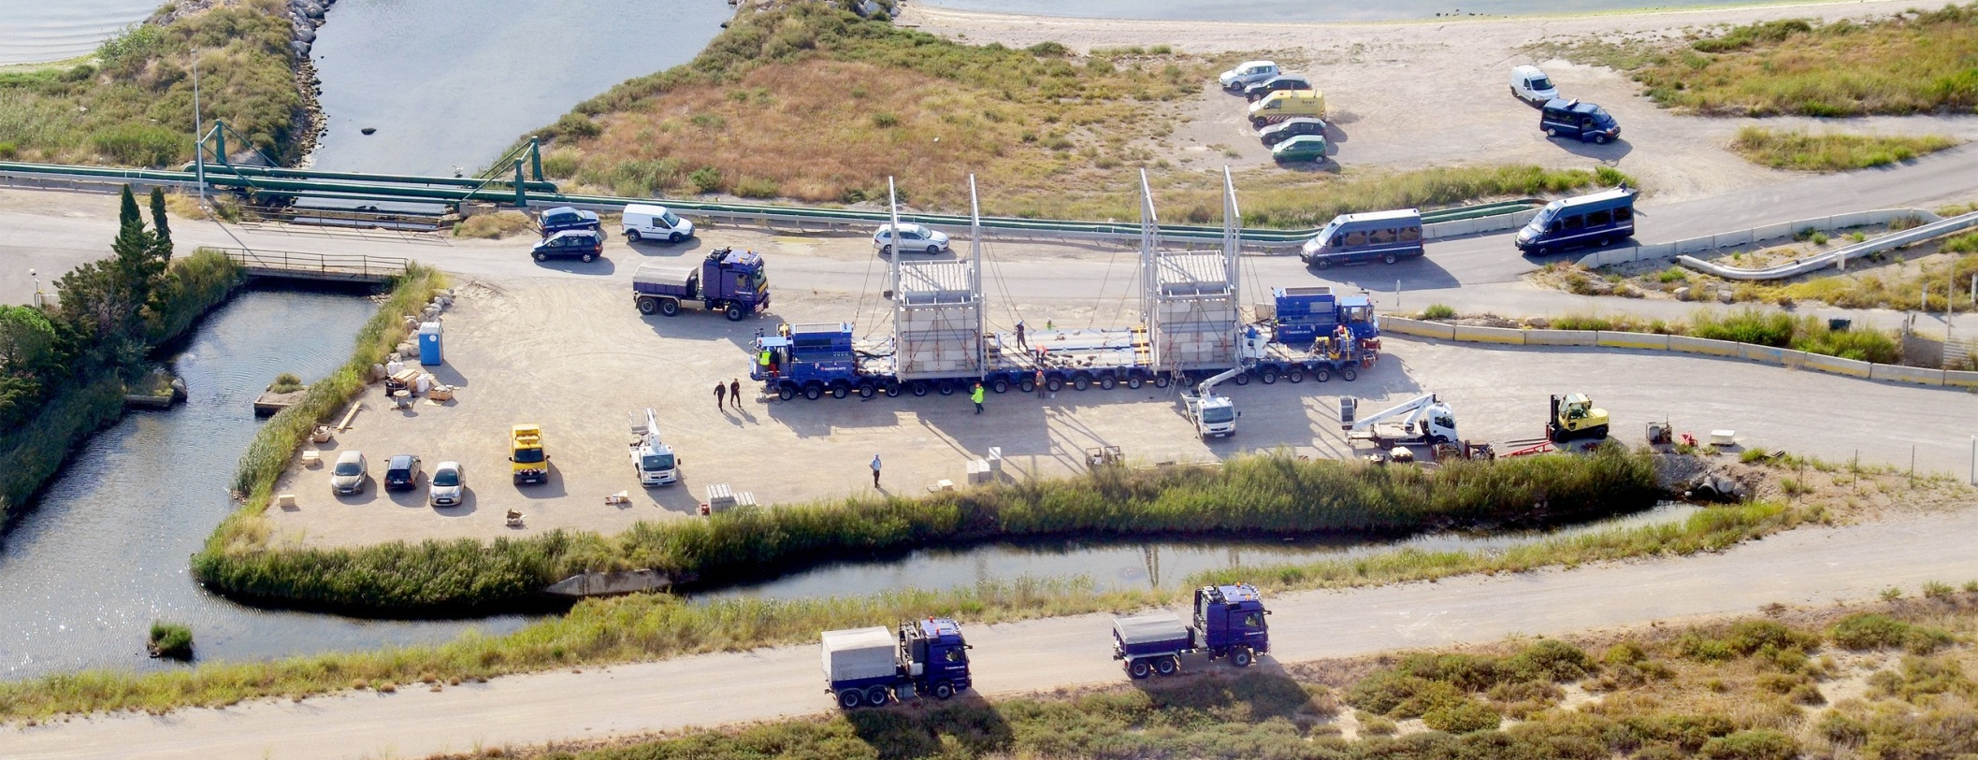
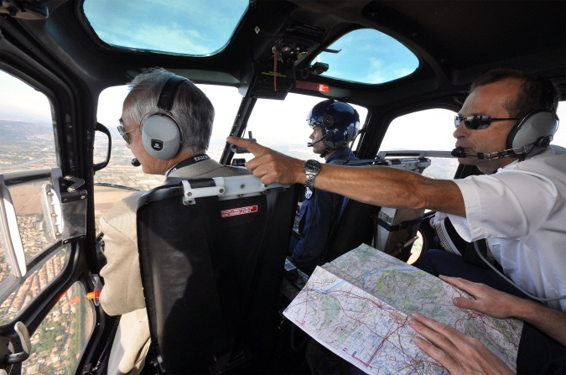
Preparations for Test Convoy
DG views test convoy from French gendarmerie helicopter

Slide 44
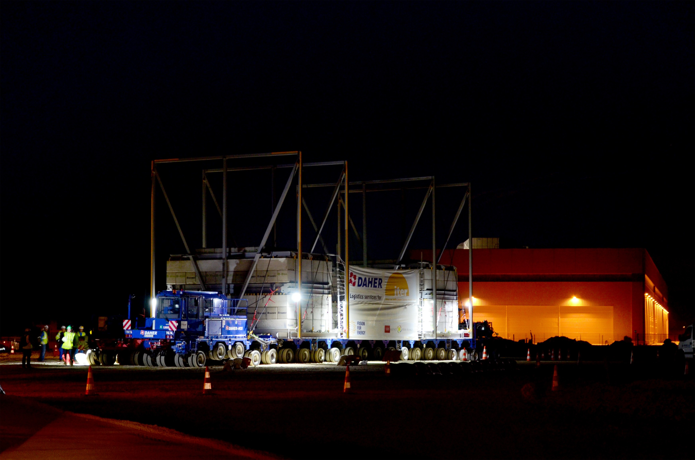
The ITER Itinerary test convoy successfully completed the last leg of its four-night journey, arriving at the ITER site at 4:45 a.m. on Friday 20th September

