Slide 1
ITM-IMP4 Status & Achievements Presented by A.H. Nielsen Project leader: B. Scott Deputy: A.H. Nielsen

Slide 2
ITM-IMP4
Project overview
ACT1 Cross verification of IMP4 turbulence codes on specified standard cases Michele Romanelli 0.15 PS It is proposed to contribute to the porting of JET experimental data into the ITM database. This will be done in cooperation with EDRG.
ACT2 IMP4 HPC workflows and interfacing with IFERC Hari Radhakrishnan and Stavros Kassinos 0.3 PS During 2012, under the task WP12-ITM-IMP4-ACT2, the basic infrastructure for reading the SOL plasma parameters was built and tested. Subroutines for reading the electron and ion temperatures, and the density from the Langmuir CPO were developed.
ACT3 Cross verification of linear and neoclassical codes on specified standard cases Jonathan Citrin 0.15 PS Cross verification of linear and neoclassical codes on specified standard cases Porting Qualikiz to ITM Pär Strand 0.08 PS Supporting the NCLASS module for IMP4
ACT4 Maintenance and standards-keeping of commonly used transport model modules Pär Strand 0.08 BS (Joint with effort in IMP3) support and extension of the Modtransp (driftwave and neoclassical) codes

Slide 3
ACT 1
Michele Romanelli, CCFE Great Britten Rui Coelho, IPFN, Lisbon, Portugal
JET data in ITM database for IMP4 (Turbulence) analysis
Three JET discharges have been selected for upload in the ITM database for IMP4 analysis (turbulence and transport). Both COREPROF, EQUILIBRIUM and CORESOURCE CPOs have been uploaded (or are in the process to be uploaded)
Experimental profiles for the selected JET discharges have been produced with JETTO. All discharges have appeared on JET publications and can be used for ITM analysis. The list of discharges is: 77922 (JETTO user dkalupin PPF sequence 476) 66128 (JETTO user ttala PPF sequence 1312) 59737 (JETTO user mroma PPF sequence 68)

Slide 4
ACT 1, continue
JET data in ITM database for IMP4 (Turbulence) analysis
The transition to a new UAL version and change in the Gateway infrastructure forced some redevelopment of the data mapping files used for JET data transfer.
New files have been provided by Rui Coelho and will be tested next week (during this code camp).

Slide 5
ACT 2 Hari Radhakrishnan, Stavros Kassinos, Nicolas Kanaris FUTURE-CY, University of Cyprus, Nicosia, Cyprus Anders Nielsen, DTU, Denmark Rui Coelho, IPFN, Lisbon, Portugal
Objectives
Use JET #59756 and #59757
Read Ne₀=0.64 1019, Te₀=23.8 eV, Ti0=60.0 eV, B_{axis}=2.43 T, q₉₅=3.91, a=0.95, R=2.96 from the equilibrium, langmuir, cxdiag CPO’s and pass them to ESEL
Extract boundary conditions from probe data and pass
Extract probe position versus time and pass it to ESEL
Compute Edge/SOL plasma state using ESEL.
Write out a new Langmuir CPO measured using a synthetic probe from the computations

Slide 6
Workflow 4.10a
ACT 2, continue
Problem with 2 UALInits solved. The 2 CXDIAG are combined in special/simpel actor, having a single CXDIAG as output

Slide 7
Snapshots
NB: Simulation is approximately 100 times longer then then below sequence
ACT 2, continue
Edge
SOL
Wall
8.5 cm

Slide 8
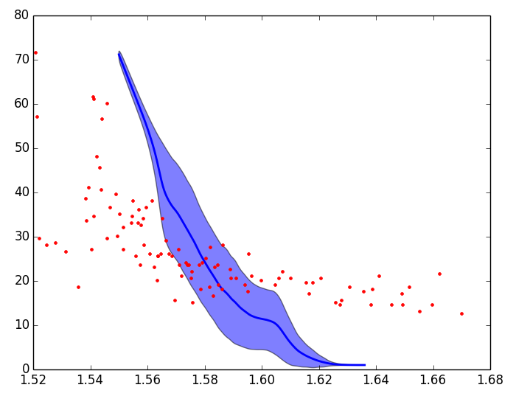
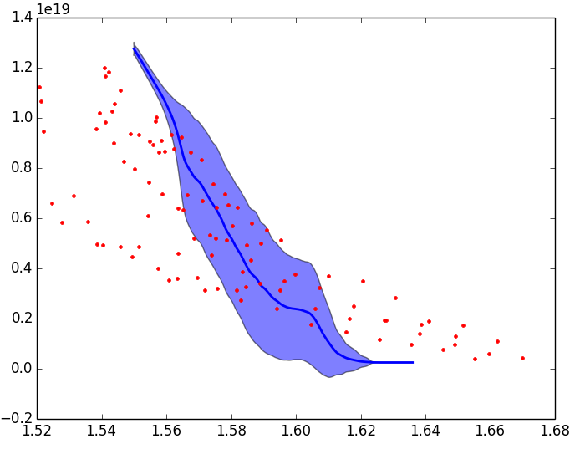
Experiment vs - Model
ACT 2, continue
Temperature
Density
Edge
SOL
Wall
Edge
SOL
Wall
LCFS (EFIT)
LCFS (EFIT)
- Thickness of SOL undefined
- Flux tube expansion from outboard midplane to probe position

Slide 9
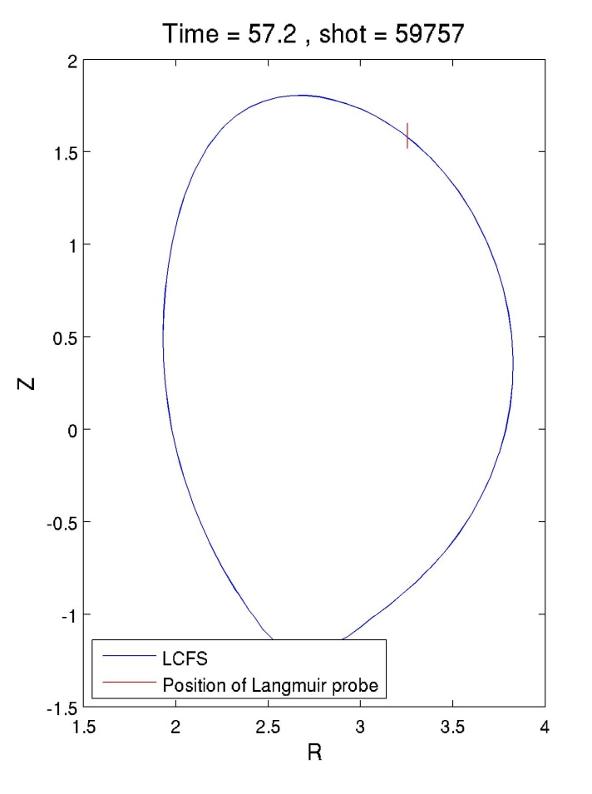
JET Shot #59757
ACT 2, continue
Probe
Simulation domain

Slide 10
IMP4-ACT 3: Cross-verification of linear and neoclassical codes on specific standard cases
Aim is to establish a set of verified toosls for modelling activities
Small number of neoclassical codes in the toolbox
Neowes
Neoart
NCLASS
Working implementations for simple cases (no multiple charge state [MCS] impurities) [NCLASS in NTCC/CEA version]
Full blown impurity versions under implementation and initial testing
Neoart running but need verification of pinch terms
NCLASS (updated) version not yet ready – still being implemented
Urgent user driven need!

Slide 11
Conclusions + outlook
ACT 1 ITM-IMP4 database contain the core-benchmark IMP4 shot 1/1 – 1/4 Will serve as test cases for new and old core/edge codes in CD1 Database also include JET shots 77922, 66128 and 59737
ACT 2 Workflow is able to read and write Langmuir CPOs Model results are comparable to experimental data Lacking experimental parameter; SOL thickness Need to work on magnetic field reconstruction This project is expected to continue in CD1 with SOL data from AUG, this will hopefully be available early 2014
ACT 3 To be maintained and expanded in CD1
ACT 4 Finished

Slide 12
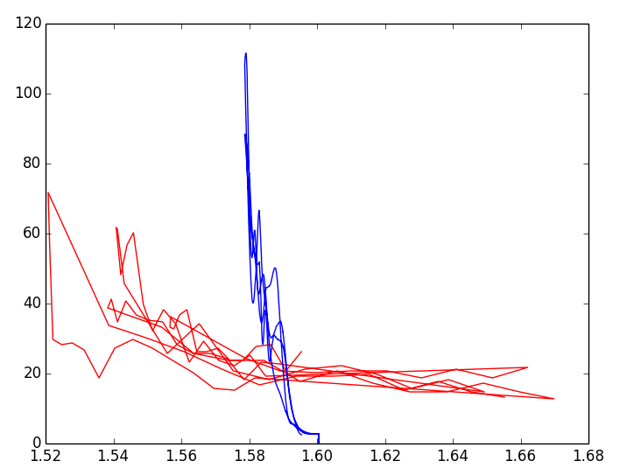
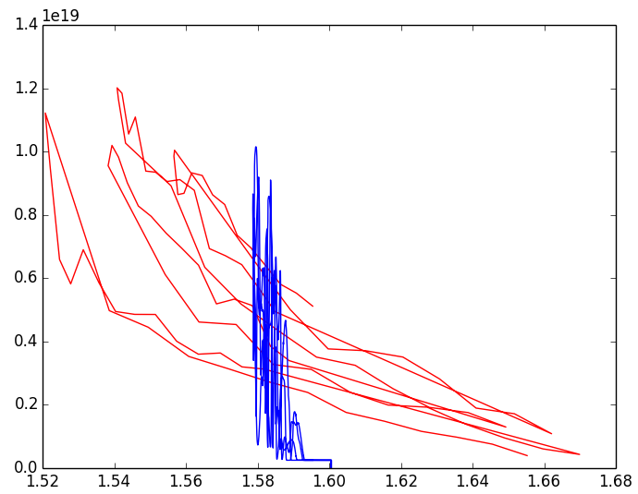
Experimental vs Synthetic Probe Data
Temperature
Density

Slide 13
Act 1
ACT1 Cross verification of IMP4 turbulence codes on specified standard cases
Experimental data to be use for the Sol, Edge, core codes in IMP4
From the Madrid CC
Uploaded JET Machine description for a generic JET pulse
Uploaded JET shots 77922 and 66128 to ITM database (to be confirmed)
Within the last month
Uploaded JET shot 59737 with help from Rui (to be confirmed)

Slide 14
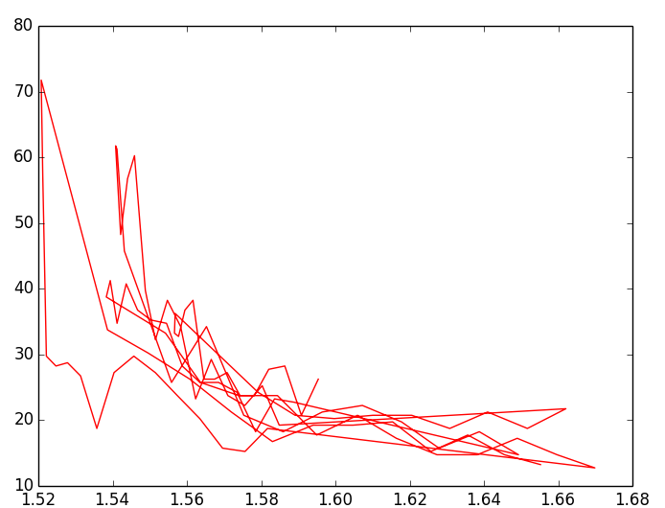
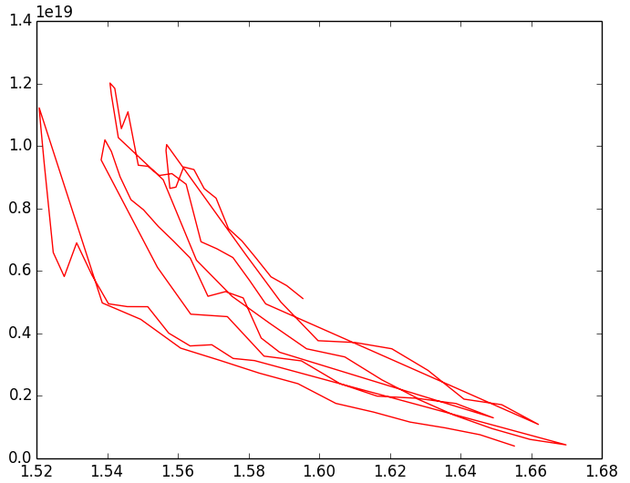
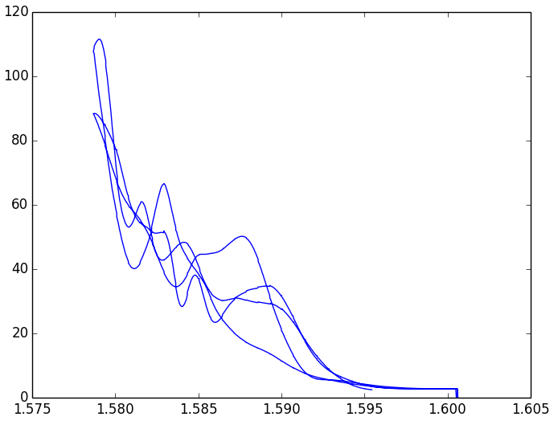
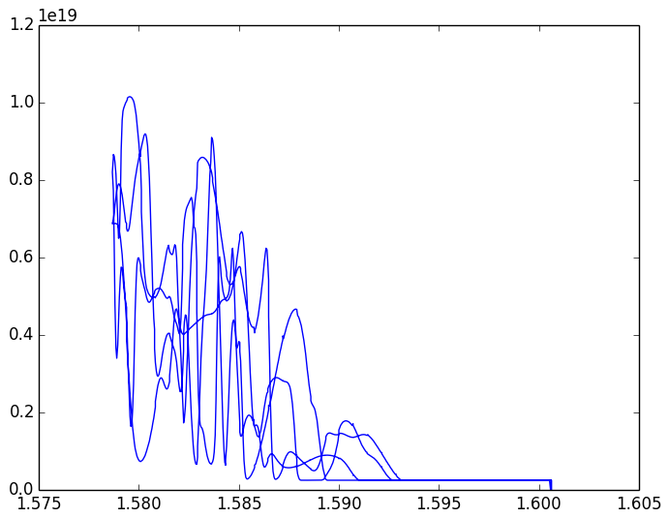
Experimental vs Synthetic Probe Data
Temperature
Density

Slide 15
ACT 3
NEOART was run on Denis K's test cases from JET (77922/2), ITER (35441/6, a good tungsten test case), DEMO1 (2/12 only, the orig EQ crashes GKMHD)
it runs on Dave C's AUG cases but fails on the MAST cases (doesn't converge near the magnetic axis)
usually you have to run a equilibrium code first to fill the CPO
(NB) just checked on IMP4 shot 1/1: agreement among NEOART/WES/NEOS for conductivity, but disagreement on JET 77922/2 ... ... this looks like a shaping issue, where they agree on circular cases but NEOART is low for shaped ones ... ... I bet I have a bug in the geometry part and am trying to hunt it down
recall the list of required inputs for IMP4 codes
there was an issue with MPI batch mdsplus access (see Tracker item 579)
this seems to work now, a 256 core case was tested and ran nominally (GKMHD -> GEM workflow)
started porting to CURIE with Michal O and Marcin P -- still some UAL issues which we are debugging
first test with manually compiled fortran workflow version ran fine on 1 core (got all IDL plot diagnostics)
the only relevant issue seems to be version matching on the XML tools
will continue with the CURIE tasks next week remotely

