Slide 1

ITM-TF Status & Achievements
Presented by G. Falchetto
TF Leader : G. Falchetto
Deputies: D.Coster, R. Coelho
EFDA CSU Contact Person: D. Kalupin
ITM Annual Meeting
21 November 2013
https://www.efda-itm.eu/

Slide 2
ITM-TF main outcomes
Developed a unique IM infrastructure
          modular, flexible, language agnostic
          machine independent
          allowing for interoperability (HPC/GRID)
Based on the definition of an ontology
  data-structure enclosing both simulated and machine data
    allows for use within different frameworks
      eases code coupling
      rigorous code verification / benchmark
    enhanced quality / reproducibility
  Developed complex workflows with multi-machine capability
ITM approach being adapted
to ITER IO IM needs

Slide 3
ITM-TF 2010-2013 Achievements
From development into deployment phase
From isolated project work to cross-project activities
Efficient and faster progress by assiduous team during Code Camps
Efficient support from full-time CPT
Verification & Validation efforts
First applications and physics results of ITM workflows
Numerous conference contributions & publications
2004
Preparatory phase
2006
Development Phase
GATEWAY
2010
Deployment
phase
2013
NEW GATEWAY
2013 technical milestones:
Deployment of ITM platform technically ready + VM tested in Associations
European Transport Simulator (ETS) including equilibrium & transport modules, impurities, NTM, H&CD (IC,EC,NBI) multi-machine tested

Slide 4
Status of ITM workflows and main 2013 Achievements
Presently available Kepler workflows
  Core workflows for MAST, TCV, AUG, JET, ITER, (DEMO)
  Equilibrium- MHD stability workflows
  Core transport workflows involving free boundary equilibria
  Core transport workflows involving impurities
Core transport workflows obtaining transport coefficients from turbulence codes
Core-edge coupled workflows
Main achievements:
Code benchmarks within ITM Kepler workflows (IMP12, IMP5)
  Equilibrium and MHD codes (ongoing)
  ECRH, ICRF codes (ongoing)
ITM workflows applied to physics studies (ISM)
  hybrid scenario modeling
  NTM effect on transport

Slide 5
Infrastructure
New EFDA-ITM Gateway cluster hosted in IPP- Garching, operational since January.
Infrastructure (ISIP)
  ITM platform deployment package (September)
    tests of VM installation ongoing in 4 EU Laboratories
  New applications:
    simulation catalogue
    workflow Monitoring & Profiling system

Slide 6
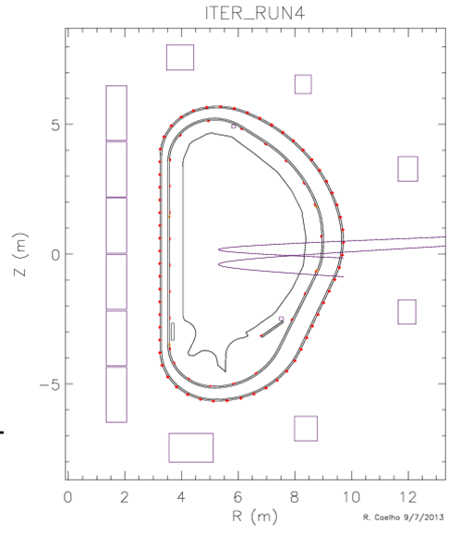
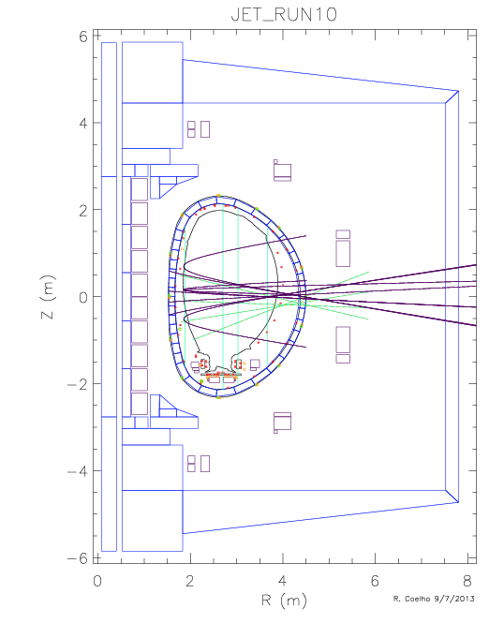
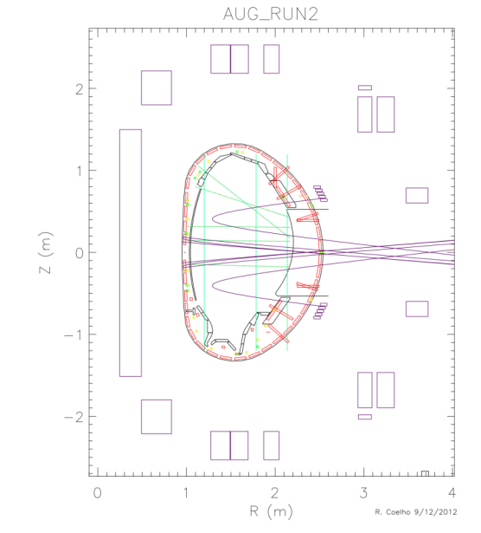
Machine description progress
EDRG
Upgrades of machine descriptions for AUG JET ITER FTU and MAST
DEMO1
  NBI beamlets
  on Asdex-Upgrade
  (ASCOT)
Thick double shell+
passive on ITER
courtesy
R Coelho

Slide 7
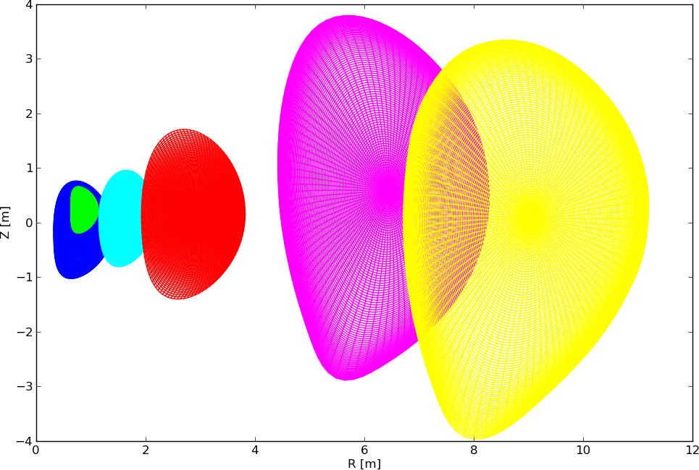
ETS Core Transport Workflows
Core workflows running under Kepler for
MAST, TCV, AUG, JET, ITER, DEMO
ETS grid
courtesy
Kalupin

Slide 8
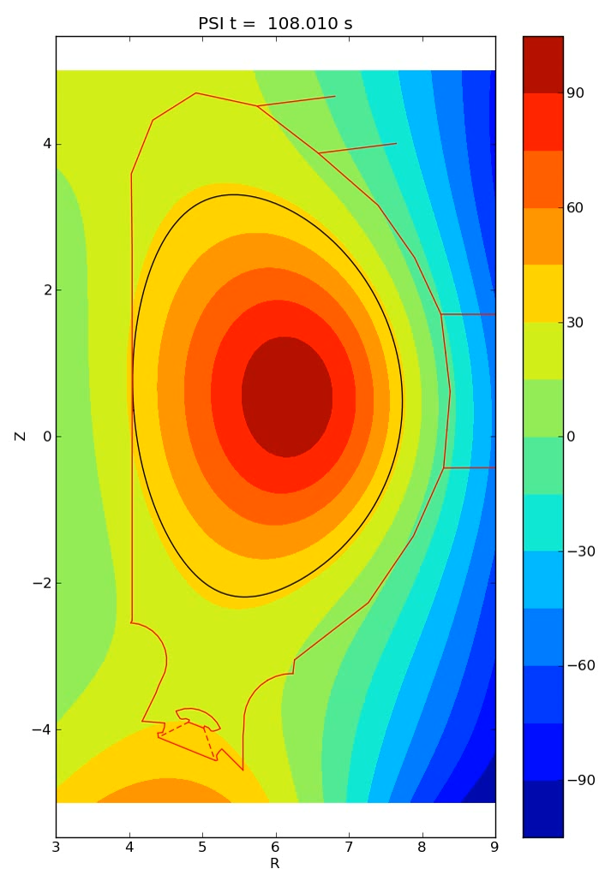
ETS + Free Boundary Equilibrium workflow
The ETS workflow now includes
a Free-Boundary Equilibrium (FBE) solver (CEDRES++, or FREEBIE):
a switch in the workflow allows to select
a FBE solver in place of a fixed-boundary solver.
Toroidal current
(visualization from CPOs)
Simulation of a VDE in ITER.
The initial plasma has I_{p}=11.8 MA,
elongation κ=1.49, limited on the HFS.
PF voltages are set to 0.
Falchetto et al NF submitted
simulation by E Nardon
visualisation from CPO
courtesy D Coster

Slide 9
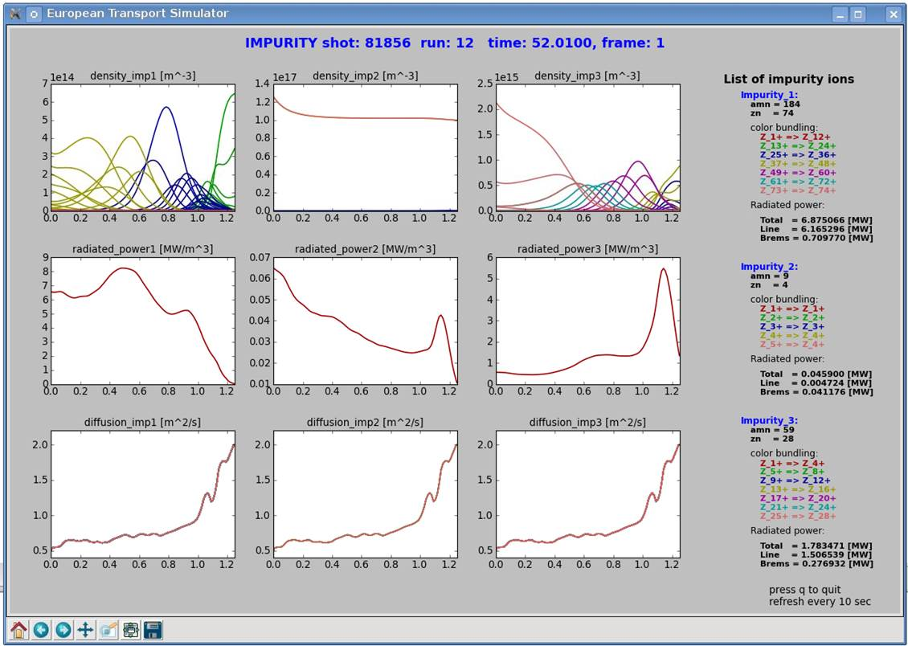
Impurity transport workflow
ETS with impurity module: evolves impurity density for arbitrary number of impurities in all ionization states (density sources for each include ionization, recombination & charge-exchange; rate coeffs. from ADAS via ITM-TF interfaces)
JET# 81856 L mode
W
Ni
Be
transport coeff. for impurity ion assumed equal to that of D
! lack anomalous transport module for impurities
courtesy
Kalupin

Slide 10
Turbulence–transport workflow
Core transport workflows obtaining transport coefficients from turbulence codes
  Kepler : was running on HPC-FF till closure in June;
    on HELIOS pending UNICORE installation / security policies
  MAPPER: running on ITM Gateway and HELIOS
  IPS: under development (with HLST) on ITM Gateway
! same ITM compliant physics codes within different frameworks

Slide 11
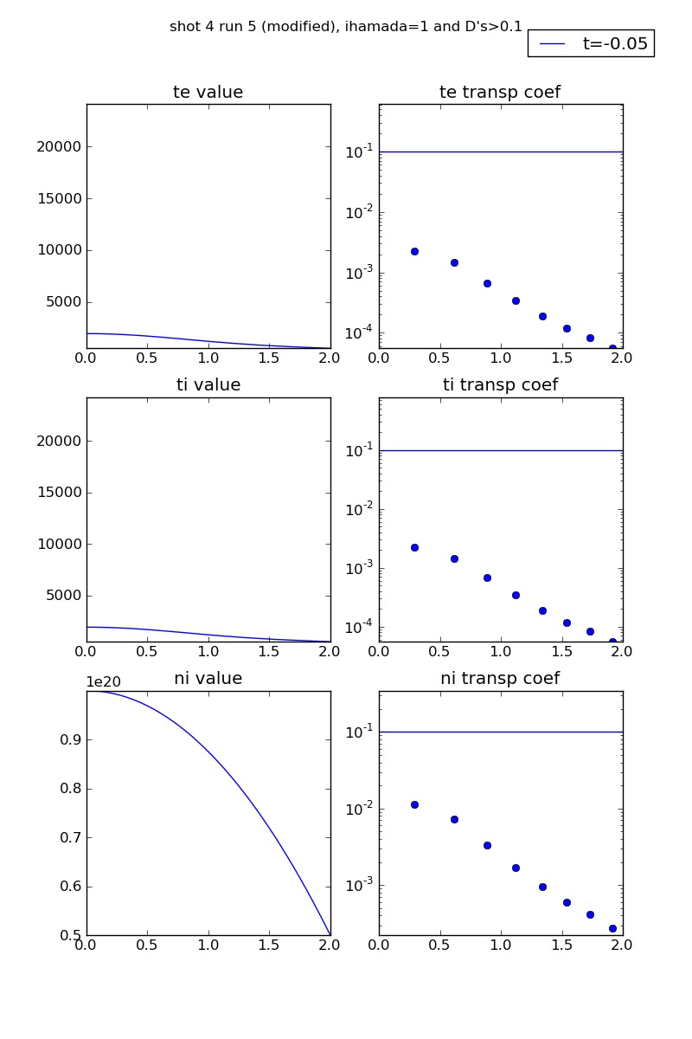
GEM - ETS workflow
Tightly coupled simulation:
reduced ETS workflow with transport coefficients provided by turbulence code
circular equilibrium ITER size
the workflow simulates 5 sec
GEM is called at each time step and runs 8 fluxtubes for 10 τ_{GB}
turbulence transport coefficients effective above a background transport threshold
density profiles not solved
GEM uses Hamada coordinates
grid 128x128 x32 (radial, drift-angle, parallel)
Workflow run on 128 cores on ITM Gateway
100 tsteps ~ 10hsCPU
courtesy O. Hoenen

Slide 12

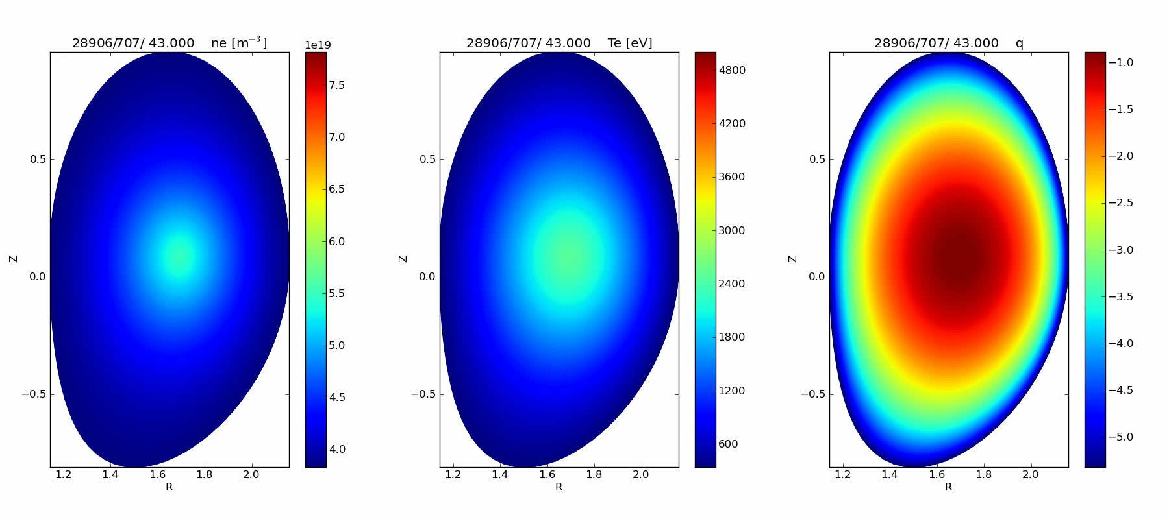
Equilibrium-Turbulence-Transport
Workflow
Within EC-FP7 project “MAPPER” (Multi-scale Applications on European e-Infrastructures”)
  gyro-fluid turbulence code GEM (8 flux tubes)
  CHEASE equilibrium code
  ETS core transport code
  300 steps in 20 hours on 256 cores
  Runs on ITM Gateway, HELIOS, other EU resources
http://www.mapper-project.eu/
courtesy of D. Coster O. Hoenen, B.Scott

Slide 13
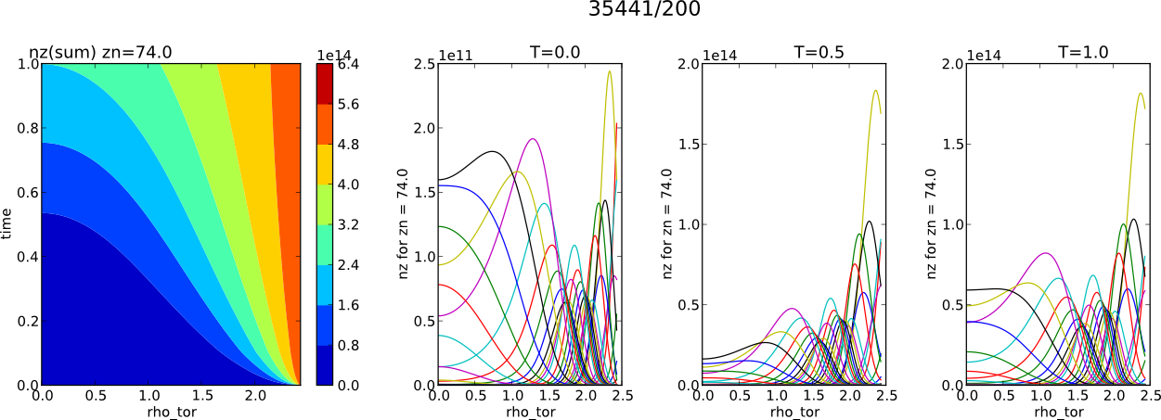
Core-Edge direct Coupling
Running as time-dependent Fortran workflows
  1 time-step core (1ms – 100 ms) [ETS + impurity + neutrals]
  1 time-step edge (0.01 ms) [SOLPS-B2]
  ITER case : D+T+Be+He+Ne+W
courtesy D Coster, H Klingshirn

Slide 14
Status of ITM workflows and main 2013 Achievements
Presently available Kepler workflows
  Core workflows for MAST, TCV, AUG, JET, ITER, (DEMO)
  Equilibrium- MHD stability workflows
  Core transport workflows involving free boundary equilibria
  Core transport workflows involving impurities
Core transport workflows obtaining transport coefficients from turbulence codes
Core-edge coupled workflows
Main achievements:
Code benchmarks within ITM Kepler workflows (IMP12, IMP5)
  Equilibrium and MHD codes (ongoing)
  ICRF codes (ongoing)
ITM workflows applied to physics studies (ISM)
  hybrid scenario modeling
  NTM effect on transport

Slide 15
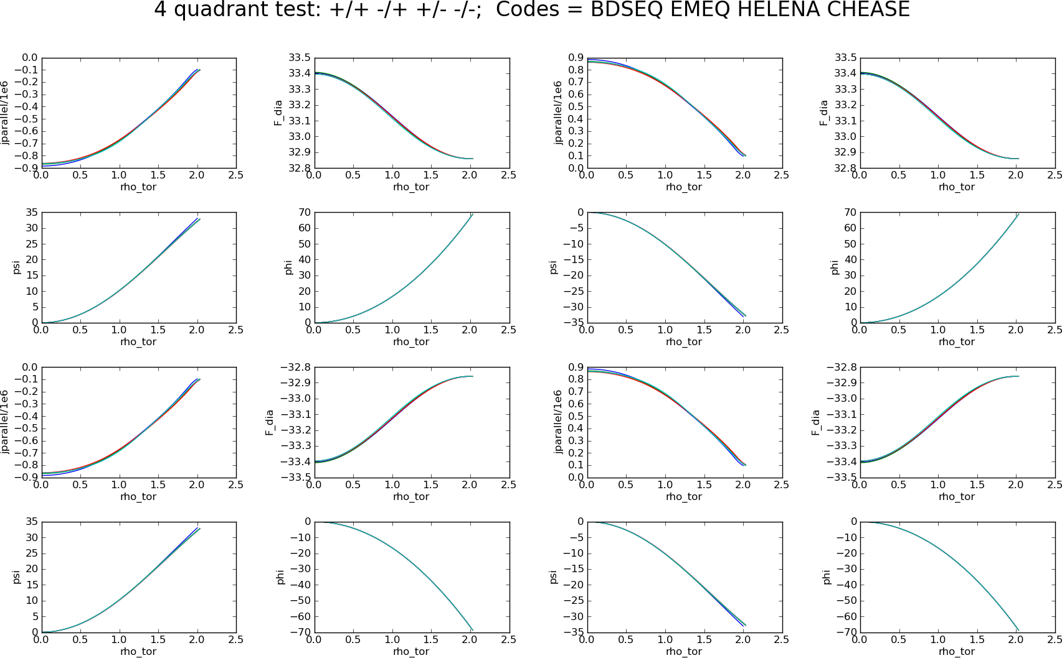
Equilibrium codes cross-benchmark
B₀
I_{p}

Slide 16
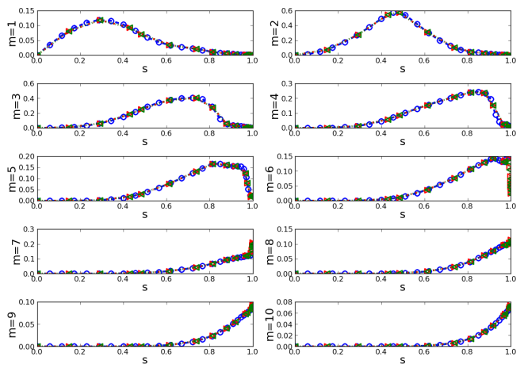
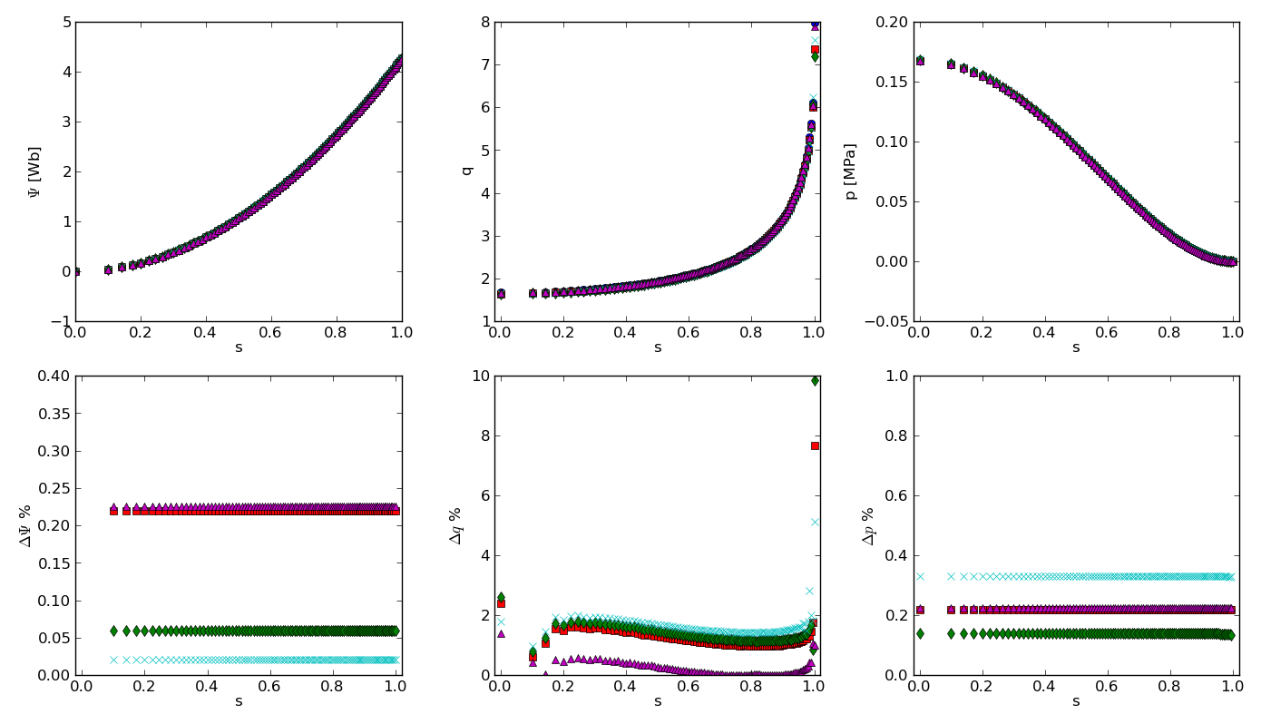
Cross-verification within equil.+ stability workflow (IMP12)
Equilibrium codes MHD stability codes
EQUAL CHEASE SPIDER
HELENA CAXE
Equilibrium reconstructed
for JET pulse #74221, t=49.199
MARS-F MARS KINX
(equil. from CHEASE + CAXE)
Φ
q
p
ΔΦ
Δq
Δp
Comparison of the poloidal flux, safety factor and pressure profiles
and correspondent accuracies.
Poloidal Fourier components (m=1-10)
of the normal displacement of n=1 mode.
D. Yadikin et al. EPS 2013

Slide 17
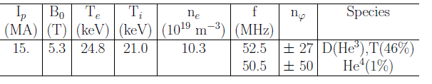
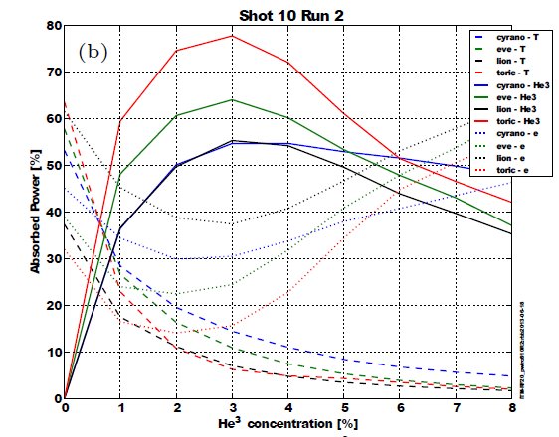
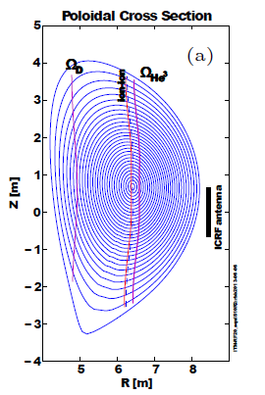
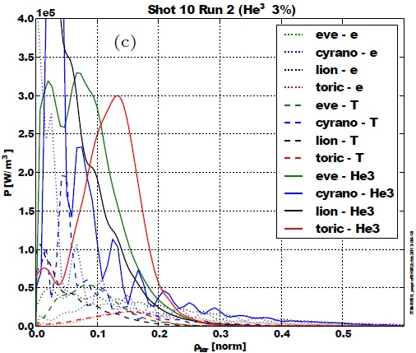
ICRF- code benchmark (IMP5)
EVE CYRANO LION TORIC
Full-field ITER case
Power repartition vs He³ concentration
Absorbed power profiles for 3% of He³
Bilato et al 20th RF Topical 2013

Slide 18
Status of ITM workflows and main 2013 Achievements
Presently available Kepler workflows
  Core workflows for MAST, TCV, AUG, JET, ITER, (DEMO)
  Equilibrium- MHD stability workflows
  Core transport workflows involving free boundary equilibria
  Core transport workflows involving impurities
Core transport workflows obtaining transport coefficients from turbulence codes
Core-edge coupled workflows
Main achievements:
Code benchmarks within ITM Kepler workflows (IMP12, IMP5)
  Equilibrium and MHD codes (ongoing)
  ICRF codes (ongoing)
ITM workflows applied to physics studies (ISM)
  hybrid scenario modeling
  NTM effect on transport

Slide 19
ITM WFs for physics studies (ISM)
Modelling of JET hybrid scenarios with ETS
(evolving Te, Ti, j, ne and C impurity)
JET77922
Data (symbols) ETS (curves)
H-mode Bohm-gyroBohm (BgB) and NCLASS (or NEOS) models, adjusted pedestal transport;
Good agreement between simulated and measured n and T for high power pulse
Temperatures are over-predicted at low plasma current and NBI power
! BgB model might be of limited use
A. Figueiredo et al EPS 2013

Slide 20
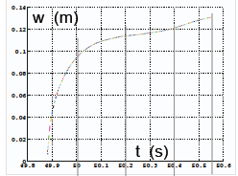
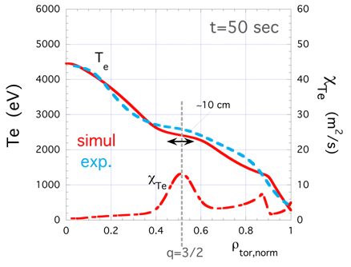
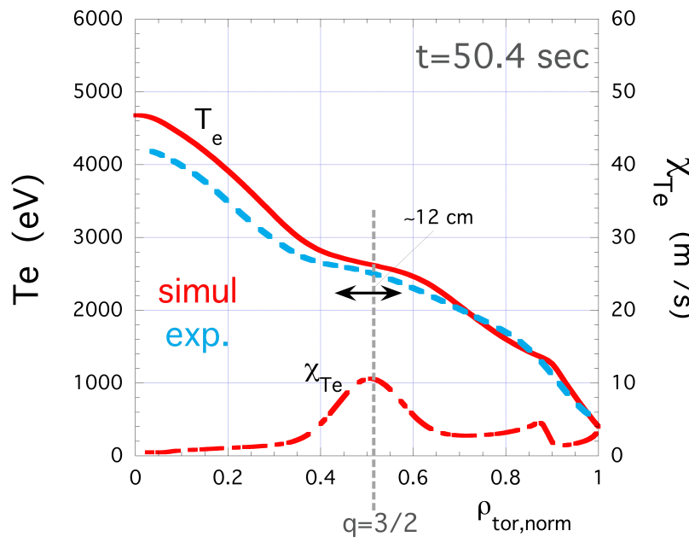
ITM WFs for physics studies (ISM)
NTM evolution and effect on transport with ETS
JET 76791
Self-consistent temperatures and density evolution with Bohm-gyroBohm and NTM modules integrated in the ETS,
for a JET shot # 76791 :
Te, ne and island width
consistent with the measurements
Island width
courtesy
S. Nowak
flattening of the island due to the 3/2 mode

Slide 21
ITM publications 2013
D. Kalupin et al. "Numerical analysis of JET discharges with the European Transport Simulator" Nucl. Fusion 53 (2013) 123007
G. Falchetto et al. , "The European Integrated Tokamak Modelling (ITM) effort: achievements and first physics results", Nuclear Fusion submitted
D. Tskhakaya, D. Coster et al.,"Implementation of PIC/MC code BIT1 in ITM platform", submitted to Contributions to Plasma Physics
X. Litaudon et al, “Modelling of Hybrid Scenario: from present-day experiments toward ITER”, Nucl. Fusion 53 (2013) 073024
G.M.D. Hogeweij et al, “Optimizing the current ramp-up phase for the hybrid ITER scenario”, Nucl. Fusion 53 (2013) 013008
J. Garcia et al, “Determination of the off-axis current for the sustainment of the q-profile on JET hybrid scenarios” Plasma Phys. Control. Fusion 55 (2013) 085006
I. Ivanova-Stanik et al, “Integrated core- SOL simulations of ITER H-mode scenarios with different pedestal density”, Contributions to Plasma Physics, 2013
João P. S. Bizarro et al, “Modelling the Ohmic L-mode ramp-down phase of JET hybrid pulses using Bohm{gyro-Bohm transport in JETTO”, Nucl. Fusion, submitted to JET Pinboard
E. Barbato et al, “Temporal simulation of Lower Hybrid Current Drive in JET discharges“, Nucl. Fusion, submitted to JET Pinboard

Slide 22
Conferences 2013
B. Guillerminet et al, "Distributed computing for Fusion simulations", 9th IAEA TM on Data Acquisition, Control and Remote Participation, 2013, Hefei China
R. Bilato et al , "ICRF-code benchmark activity in the framework of the European Task-Force on Integrated Tokamak Modelling", 20th RF Topical Conf., Sorrento 2013
D. Yadikin et al., "Verification of the equilibrium and MHD stability codes within the Integrated Tokamak Modeling Task Force framework." EPS 2013
A. Figueiredo et al, “Modelling of JET hybrid scenarios with the European Transport Solver”, EPS 2013
G. Fogaccia , S. Briguglio, G. Vlad, "Benchmark of the HYMAGYC code", EPS 2013
L. Kos et al., "Unified Approach to Visualizations within the European Integrated Tokamak Modelling Framework", NENE2013
K.Tőkési, P. Salamon, D. Tskhakaya, and D. Coster, "Universal functional formula of atomic elastic cross sections. The case of the hydrogen target.", ICPEAC 2013
8th Workshop on Fusion Data Processing, Validation and Analysis, Ghent, Nov 2013:
  M. Irishkin, "Automated comparison of experimental density profile reconstruction with models"
  W. Zwingmann, "Reconstruction of the Plasma Equilibrium State in Fusion Devices"
J. Urban et al., "Status and Benchmarking of the Free Boundary Equilibrium Code FREEBIE", APS2013

Slide 23
Conferences 2013 (ISM)
B. Baiocchi et al, “Turbulent transport analysis of JET H-mode and hybrid plasmas using QuaLiKiz, TGLF and GLF23”, EPS 2013
F. Köchl et al, “Integrated core + edge + MHD modelling of ELM mitigation at JET”, EPS 2013
P. Siren et al, “Current profile modelling in JET and JT-60U identity plasma experiments”, EPS 2013
I. Ivanova-Stanik et al, “Integrated core- SOL simulations of ITER H-mode scenarios with different pedestal density”, PET2013
14th International Workshop on H-mode Physics and Transport Barriers, Fukuoka, Japan , 2-4 October 2013
  G.M.D. Hogeweij et al, "Modelling of ITER-like current ramps in JET with ILW: lessons for ITER regarding H-mode and li control"
  J. Garcia et al, "Physics comparison and modeling of JET and JT-60U core and edge: towards JT-60SA predictions"
IOS ITPA topical group meeting, 7-10 October 2013, Japan
  I. Voitsekhovitch, C. Kessel, "Proposals on modelling of density profiles in ITER baseline" (presented by C. Kessel)
  I. Ivanova-Stanik et al, "Integrated core-SOL-divertor-impurity simulations for ITER H-mode" (presented by J. Garcia)

Slide 24
Conclusions
  10 years of ITM-TF !
  ☺ Efficient collective development
    built a framework valuable for ITER IM
    enhanced quality of code benchmarks
    built various workflows with multi-machine capability
    produced first physics results with ITM workflows
☺ Created an EU community of developers and modellers
    ISM Group in link to ITER, ITPA, JT60SA
A sincere thank you to all the ITM-TF contributors, ISM group, Project Leaders and TF leaders
WITHIN THE NEW EU STRUCTURE
WE HAVE TO and WILL SHOW
IT WAS WORTH THE EFFORT !

Slide 25
ITM publications 2013 (cont.)
S Wiesen, Integrated ITER scenario modelling and density evolution prospects, NF submitted ?

