Slide 1
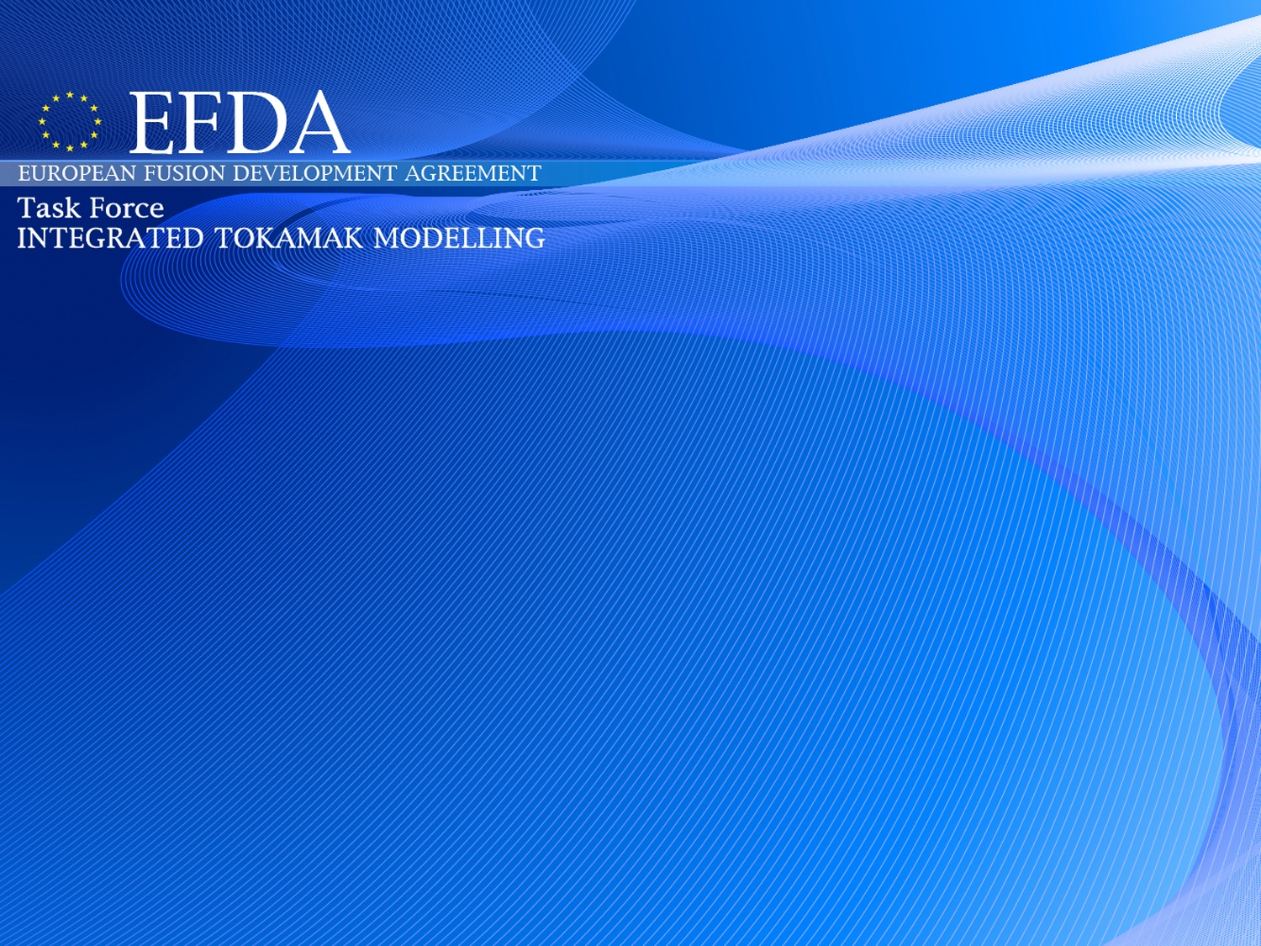
ITM General Meeting 13-12-2012
IMP12 – 2012
Equilibrium, MHD, and Disruptios
Presented by E. Giovannozzi, D. Yadykin
on behalf of
Atanasiu Calin-Vlad, Blaise Faugeras, Cédric Boulbe, Dimitris Dimopoulos, Dumitru Daniel, Eric Nardon, Emiliano Fable, Fabio Villone, Georgios Poulipoulis, Georgios Throumoulopoulos, Gregorio Vlad, Jacques Blum, Jakub Urban, Jean-François Artaud, Joachim Geiger, Laurent Villard, Lynton Appel, Maurizio Ottaviani, Nikos Pelekasis, Olivier Sauter, Oliviero Barana, Philippe Moreau, Rémy Nouailletas, Silvana Nowak, Sotiris Kakarantzas, Stefano Mastrostefano, Sylvain Brémond, Yueqiang Liu, Yves Buravand, Wolfgang Zwingmann
TF Leader : G. Falchetto
Deputies: D.Coster, R. Coelho
EFDA CSU Contact Person: D. Kalupin

Slide 2
IMP12 tasks in 2012
ACT1 - Integration of equilibrium and MHD modules into ITM Workflows and Maintenance of IMP12 codes (PS)
ACT2 - Development and integration of standalone MHD modules and codes (BS)
ACT3 - Verification and Validation (PS)
Number of active members in 2012: 30
  2.66 ppy (Priority Support)
  4.22 ppy (Baseline Support)
number of proposals: 19

Slide 3
ACT1 - Integration of equilibrium and MHD modules into ITM Workflows
T1: Equilibrium and MHD stability chain (MARS-F, CarMa,ILSA,CHEASE,SPIDER,HELENA,EQUAL,CAXE,KINX)
T2: Integration of MHD modules with the European Transport Solver (NTMwf)
T3: Integration of free boundary equilibrium codes with the European Transport Solver (FREEBIE, CEDRES)
T4: Coupling of free boundary equilibrium codes with a feedback controller (FREEBIE, CEDRES)
T5: MHD control workflow (MARS-F)
T6: Maintenance of codes belonging to the above workflows
  Introduction of COCOS number.

Slide 4
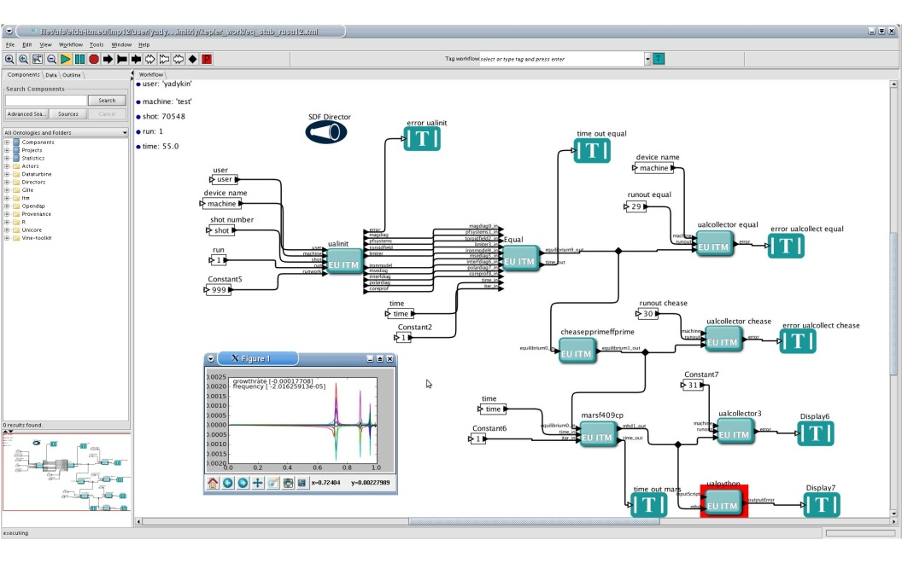
ACT1-T1 MHD stability chain (a)
EQUAL → CHEASE → MARS-F
Purpose of the chain: study linear stability of the high β plasmas (ideal kink modes, Resistive Wall Modes)
Codes :
  EQUAL – free-boundary reconstruction equilibrium code
  CHEASE – fixed boundary equilibrium code
  MARS-F – linear MHD stability code
Input: tokamak description
Output: Eigenvalue and eigenfunctions (plotted using ualpython actor) of the MHD mode
Workflow status: tested for JET pulse (include ACT3-T1 results on EQUAL)

Slide 5
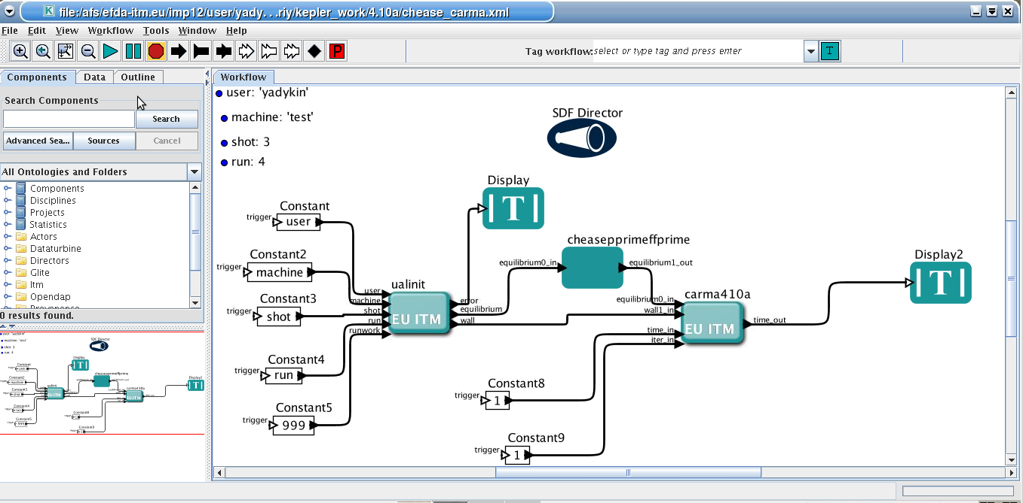
ACT1-T1 MHD stability chain (b)
CHEASE → CarMa
Purpose: study linear MHD stability of the high β plasma using realistic model of the 3D wall
Codes :
CHEASE – fixed boundary equilibrium code
CarMa – linear MHD stability code
Input: equilibrium and wall geometry
Output: eigenvalue and eigenfunctions (current pattern in the wall) of the MHD mode
Workflow status: initial tests are performed, work on the 3D wall integration is in progress.

Slide 6
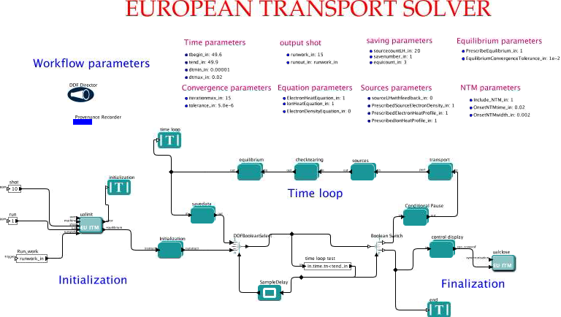
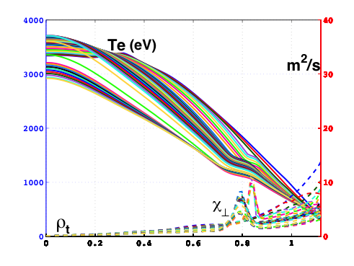
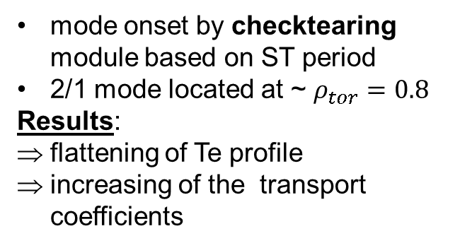
Act1 – T2 Integration of NTM module in ETS workflow
checktearing
NTM actor in Transport

Slide 7
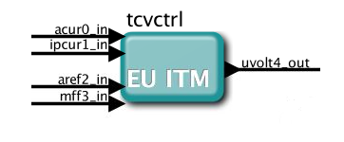
ACT1 – T3 T4 – Progress in free boudary equilibrium code CEDRES
Working group:
O. Barana, J. Blum, C. Boulbe, S. Brémond, B. Faugeras, E. Nardon, R. Nouailletas
Tasks performed:
Simulations using workflow CRONOS-CEDRES/FREEBIE + controller for ITER ramp up tested outside ITM environment
Integration of the free-boudary equilibrium solver to the ETS
  ETS-CEDRES loop with partial coupling: VDE in ITER
  ETS-CEDRES workflow with full coupling
Implementation of controller in the free-boundary equilibrium workflow
  Controller actor is generated from Simulink TCV controller provided by CRPP
  TCV simulation in open loop: VDE is well reproduced
TCV controller actor

Slide 8
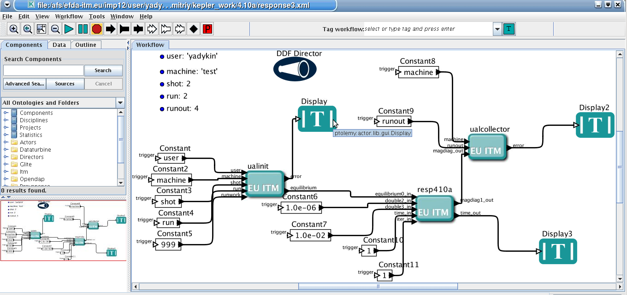
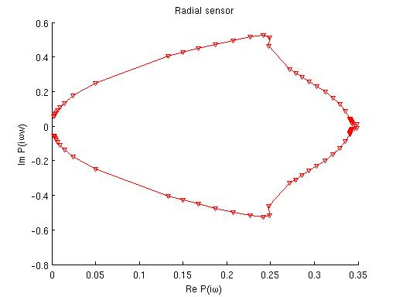
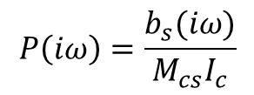
ACT1-T5 MHD control workflow
Purpose: stability studies of Resistive Wall Mode in the presence of the active control
Method: use plasma response P(iω) to the external perturbation
(Y.Q.Liu, CPC, 176 (2007) 161)
Input (currently): equilibrium, frequency range
Output (currently): plasma response to the unit current perturbation
b_{s}(iω) –field measured by sensor
I_{c} – current in the active coil
M_{cs} – mutual inductance between active coil and sensor
Workflow status: response function is obtained for the JET-like equilibrium, controller design is in progress.

Slide 9
ACT2 - Development and integration of standalone MHD modules and codes
Adaptation and integration of new codes to the ITM infrastructure, porting on the Gateway and Gforge SVN, creation of a Kepler actor.
Adaptation of codes under development in the Associations during 2011 already ported to the Gateway, up to the stage of a tested Kepler actor.

Slide 10
ACT2 - Resistive Wall Mode
New RWM code
A new code to calculate the response of a 3D thin multiple connected wall to an external kink mode (a RWM mode) in diverted axisymmetrical tokamak configurations by using orthogonal curvilinear coordinates in place of the Cartesian ones, has been developed.
.
Analytical solutions
To check our numerical results, an analytical model for a closed shell in both poloidal and toroidal directions, based on our single layer approach has been developed. Any combination of both poloidal and toroidal wave numbers is possible.
WP12-ITM-IMP12-ACT2-T1 Calin Atanasiu (MEdC Association)

Slide 11
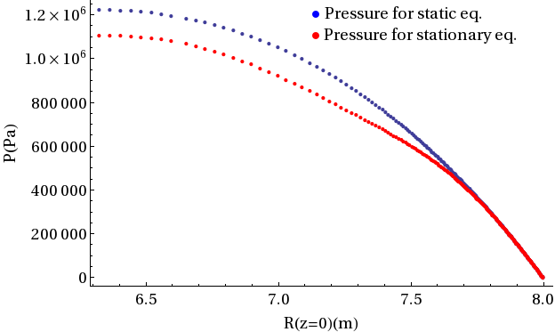
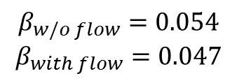
ACT2 – equilibrium with flow
Solovev type equilibrium with parallel plasma flow.
Mach number on axis is 0.1
$$β_{w/o flow}=0.054$$
$$β_{with flow}=0.047$$
The perpendicular flow is not yet included, work in progress.
WP12-ITM-IMP12-ACT2-01/Hellenic Republic - Georgios Poulipoulis

Slide 12
Act 3 - Verification and Validation
T1: Continued validation of the EQUAL equilibrium reconstruction code on JET data.
T2: Continued validation of the EQUAL equilibrium reconstruction code on Tore Supra data.
T3: Verification of equilibrium and MHD stability codes (CHEASE, HELENA, SPIDER, MARS, MARS-F)

Slide 13
ACT3 – T1/T2 EQUAL reconstruction equilibrium code
Status and Achievements 2012:
  Upgrade of EQUAL code, actor and workflow to UAL 4.10a
  Installation of EQUAL on Tore Supra computers in collaboration with R.Masset and P.Lotte from CEA:
    EQUAL code on Gateway and on local computers kept identical according to ITM standards
    Interface with tslib (CEA) for reading TS data and fill CPOs used by EQUAL
    Writing back equilibrium CPO to tslib
    Licence for CEA to use ITM code EQUAL for Tore Supra data
Challenge for 2013:
  Verification (Validation) of Faraday rotation data for Tore Supra and JET
  Installation of EQUAL on JET JAC computer and interface with the PPF system (with V.Drozdov and M.Romanelli)
  EQUAL runs for TCV (with H.Reimerdes) and ASDEX
  (Wolfgang Zwingmann)

Slide 14
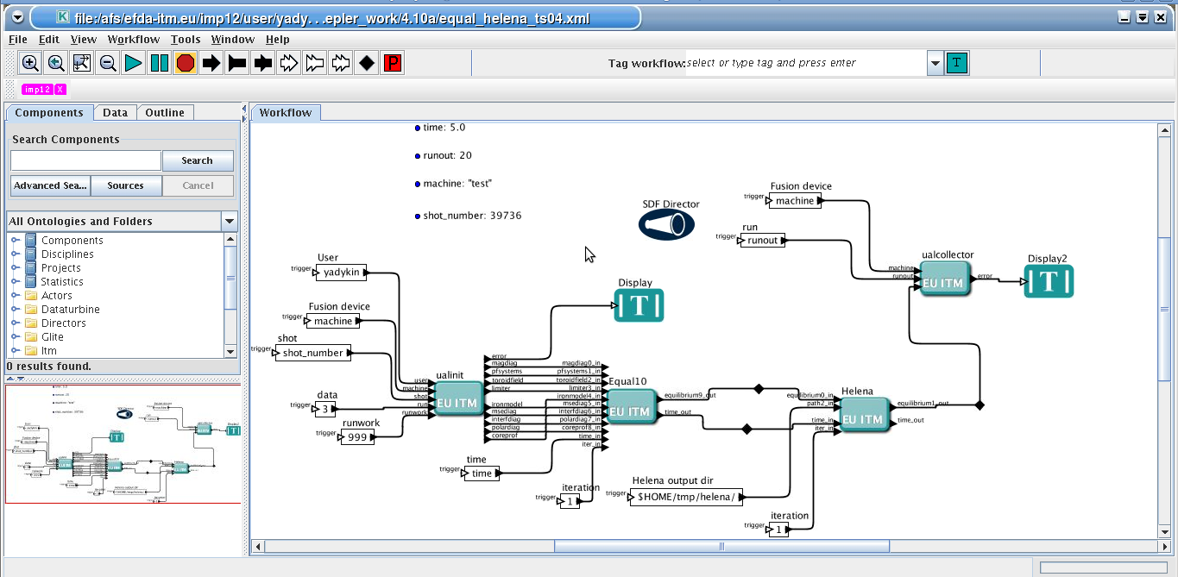
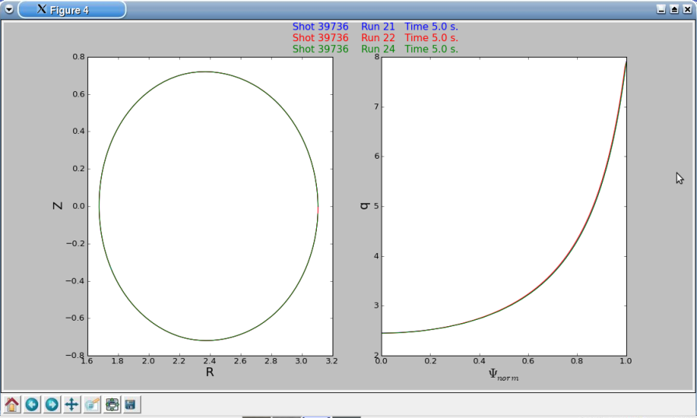
ACT3-T3 Verification of equilibrium and MHD stability codes (a)
Equilibrium codes
Purpose: verification of IMP12 fixed equilibrium codes
Codes involved: CHEASE, HELENA, SPIDER
Method: use output of the EQUAL code (ACT3-T2) as input and compare the results obtained using involved codes
Results: profiles (pressure, safety factor, ets.), metric coefficients for the transport and stability calculations are compared for TORE SUPRA equilibrium. Profiles are in agreement
CHEASE
SPIDER
HELENA

Slide 15
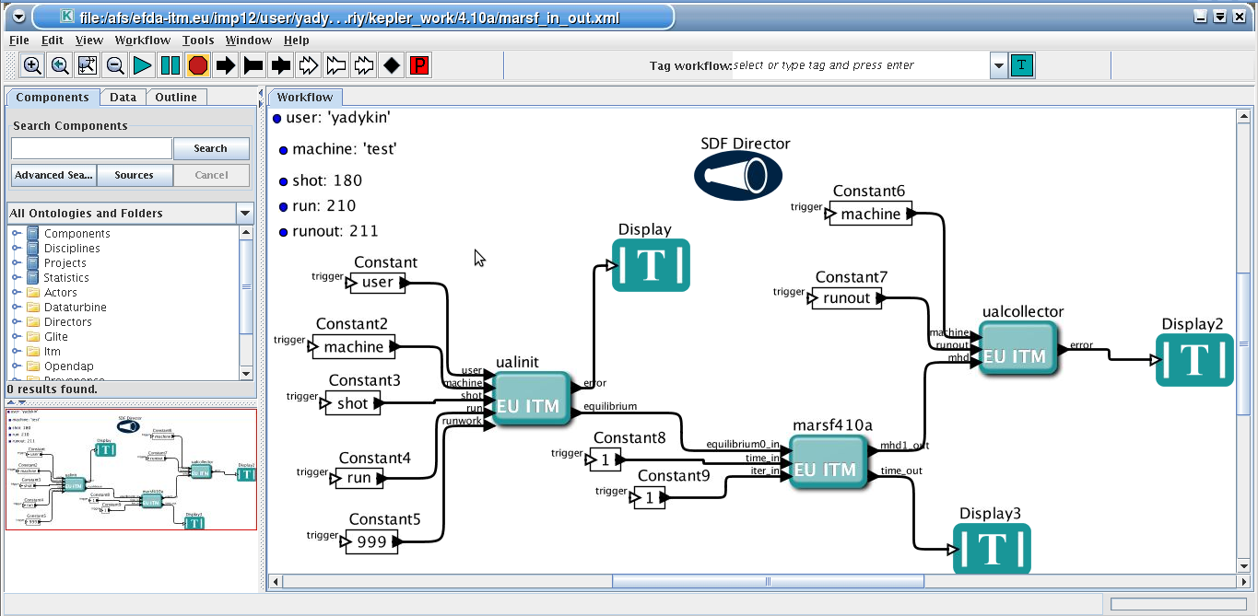
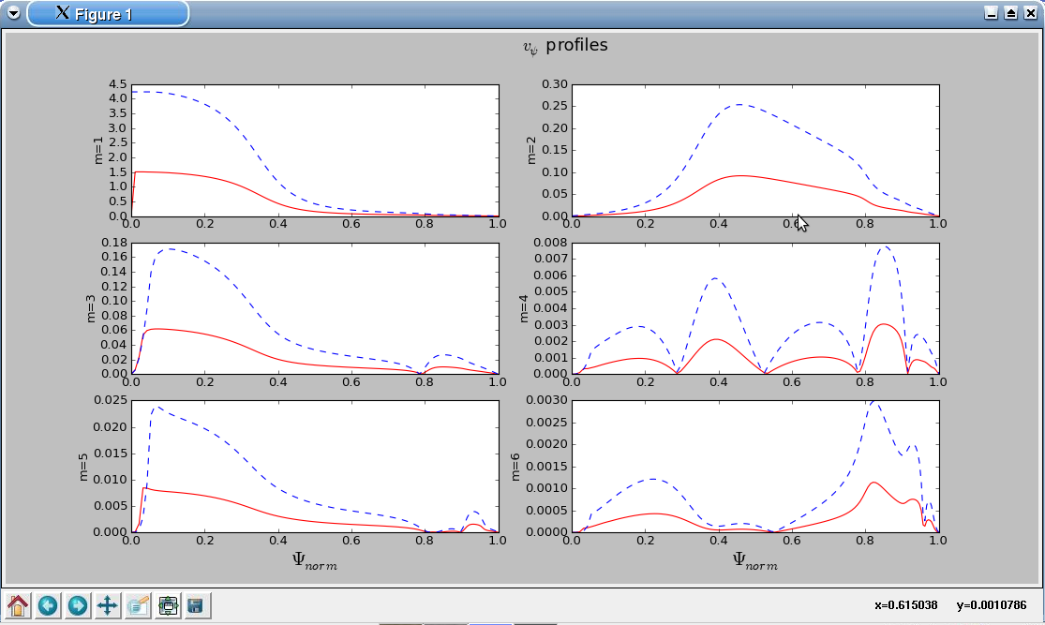
ACT3-T3 Verification of equilibrium and MHD stability codes (b)
Linear MHD stability codes
Purpose: verify IMP12 linear MHD stability codes
Codes involved: MARS, MARS-F
Method: compare eigenvalues and eigenfunction profiles for test equilibrium using involved codes
Results: eigenvalue and eigenfunction profiles are compared for test equilibrium unstable to the internal n=1 mode. Results are in agreement apart from the normalization coefficient. The reason for discrepancy is under investigations
MARS
MARS-F

Slide 16
Conclusions
Equilibrium MHD stability chain for stability studies in high beta plasma is developed (including 3D wall elements).
Verification of the codes in the equilibrium MHD stability chain is in progress.
Free boundary equilibrium and NTM stability modules are integrated in the ETS workflow.
Free boundary code coupling with feedback controller is in progress.

Slide 17
Plans for 2013, Challenges
Cross validation of the codes
Integration of IMP12 codes in the various workflows (transport, turbulence, heating).
Integration of the codes with controllers developed by EDRG.
New codes
  3D equilibrium (stability)
  non-linear codes
Additional codes will be ported to ITM

Slide 18
Codes
CarMa | Linear MHD stability code (RWM) 3D wall. | Tested actor integrated in stability chain workflow. Work on the 3D wall description in ITM is in progress
MARS | Linear MHD stability code (ideal and resistive) | Tested actor integrated inside a IMP5 workflow
MARS-F | Linear MHD stability code (ideal and resistive, RWM with feedback) | Integrated inside the Equilibrium stability CHAIN workflow
ILSA | Linear MHD stability (edge and global MHD modes) | Tested actor integrated in equilibrium stability chain
CHEASE | Fixed equilibrium solver | Well tested actor, integrated in the stability chain
SPIDER | Fixed and Free boundary equilibrium code | Fixed boundary version tested and integrated in the ETS.
CAXE | Fixed boundary | ITM module
KINX | Linear stability | ITM module
NTMwf | NTM code (island width dynamic) | Integrated with the ETS in a workflow.
Equal | Reconstruction equilibrium sover | Tested and integrated in equilibrium stability chain
FreeBie | Free Boundary Equilibrium Code | Integrated with the ETS in a workflow.
Cedres | Free Boundary Equilibrium Code | Integrated with the ETS in a workflow.

